Slide 1

Comparing Mutual
Information in Finite
Samples
Can MI-specific degrees of freedom improve comparisons between populations?
Daniel Zhao (Master of Computer Science)
Supervisor: Associate Professor Joseph T. Lizier
The University of Sydney
Notes:
Hi everyone, today I'll talk about comparing mutual information between two populations.

Slide 2
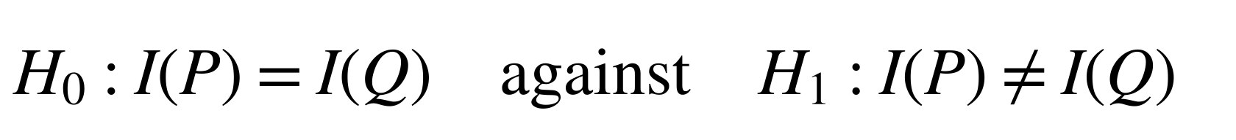
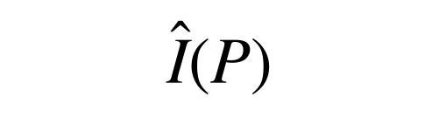
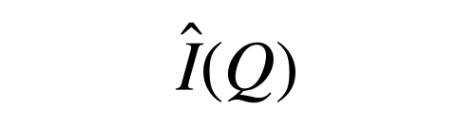
Motivation: comparing MI across populations
Mutual information measures how much observing one variable reduces uncertainty about another, on average. Different sample estimates can arise from sampling noise.
Hypotheses
$$H_{0}:I\left(P\right)=I\left(Q\right) \text{against} H_{1}:I\left(P\right)≠I\left(Q\right)$$
Two populations, the same two discrete variables
Statistical task
Population P
𝑛_{𝑃} observed pairs (𝑋, 𝑌)
MI estimate
Summarise a sample from each population in a count table
$$\hat{I}\left(P\right)$$
Estimate MI from each table
Population Q
𝑛_{𝑄} observed pairs (𝑋, 𝑌)
MI estimate
$$\hat{I}\left(Q\right)$$
Assess whether sampling noise can explain the difference
Both variables are discrete (categorical), giving count tables.
Example: 𝑋 = mid-semester test grade, 𝑌 = final exam grade; 𝑃 = students before generative AI, 𝑄 = students after.
Does MI differ between the two populations?
Table icons are schematic; the example is illustrative, not thesis data. Thesis Sections 1.1 and 2.1; Bossomaier et al. (2016)
2
Notes:
Mutual information, or MI, measures how much knowing one variable reduces uncertainty about another, on average. If the variables are independent, MI is zero.
The hypotheses at the top compare MI for the same two categorical variables, X and Y, in populations P and Q. The null says their population MI values are equal. The alternative says they differ.
On the left, each observation gives us a pair: one category for X and one for Y. We count how often each pair occurs and estimate MI from that count table. We do that for each population. Even if the populations have equal MI, those estimates can differ. So the last step on the right asks whether sampling noise could explain the difference we see.
In the example at the bottom, imagine X is a student's mid-semester test grade and Y is their final exam grade, both recorded as categories. The two populations are students before and after generative AI. Does knowing the mid-semester grade tell us as much about the final grade in both groups?

Slide 3
Literature review: foundations and the MI-specific step
Existing results provide MI estimates, a Wald test using a standard normal distribution, and moment matching.
This project derives the MI variance sensitivity needed for its degrees of freedom.
 | MI estimation and uncertainty | Wald comparison | Welch–Satterthwaite moment matching
Idea | Estimate MI and first-order sampling variance | Divide the estimated difference by its standard error | Match variance moments to choose degrees of freedom
Key work | Moddemeijer (1989); Paninski (2003) | Wald (1943); Mora and Ruiz-Castillo (2009) | Satterthwaite (1946); Welch (1947); Hutcheson (1970); Pan and Wall (2002)
Required step | Track variation in the variance estimate itself | Assess the fixed cutoff from the standard normal distribution in finite samples | Calculate the MI-specific variance sensitivity
Contributions: Derive that sensitivity, construct the Expanded Welch test from it, and evaluate both empirically.
Thesis Sections 2.2–2.5 and 3.2–3.3; full references on Slides 32–33
3
Notes:
The left column gives us an MI estimator, a leading bias correction, and a first-order approximation for its sampling variance. The step I need is to work out how much the variance estimate itself changes between samples.
In the middle is the Wald test. It uses the standard normal distribution to approximate how the test statistic behaves when population MI is equal. I check how well that cutoff works in finite samples.
The right column introduces Welch–Satterthwaite moment matching. It uses the mean and variance of the estimated variance contributions to choose degrees of freedom. For MI, that requires a new calculation of variance sensitivity.
At the bottom are my three steps: derive that sensitivity, use it to construct the Expanded Welch test, and compare the two tests in simulations.

Slide 4
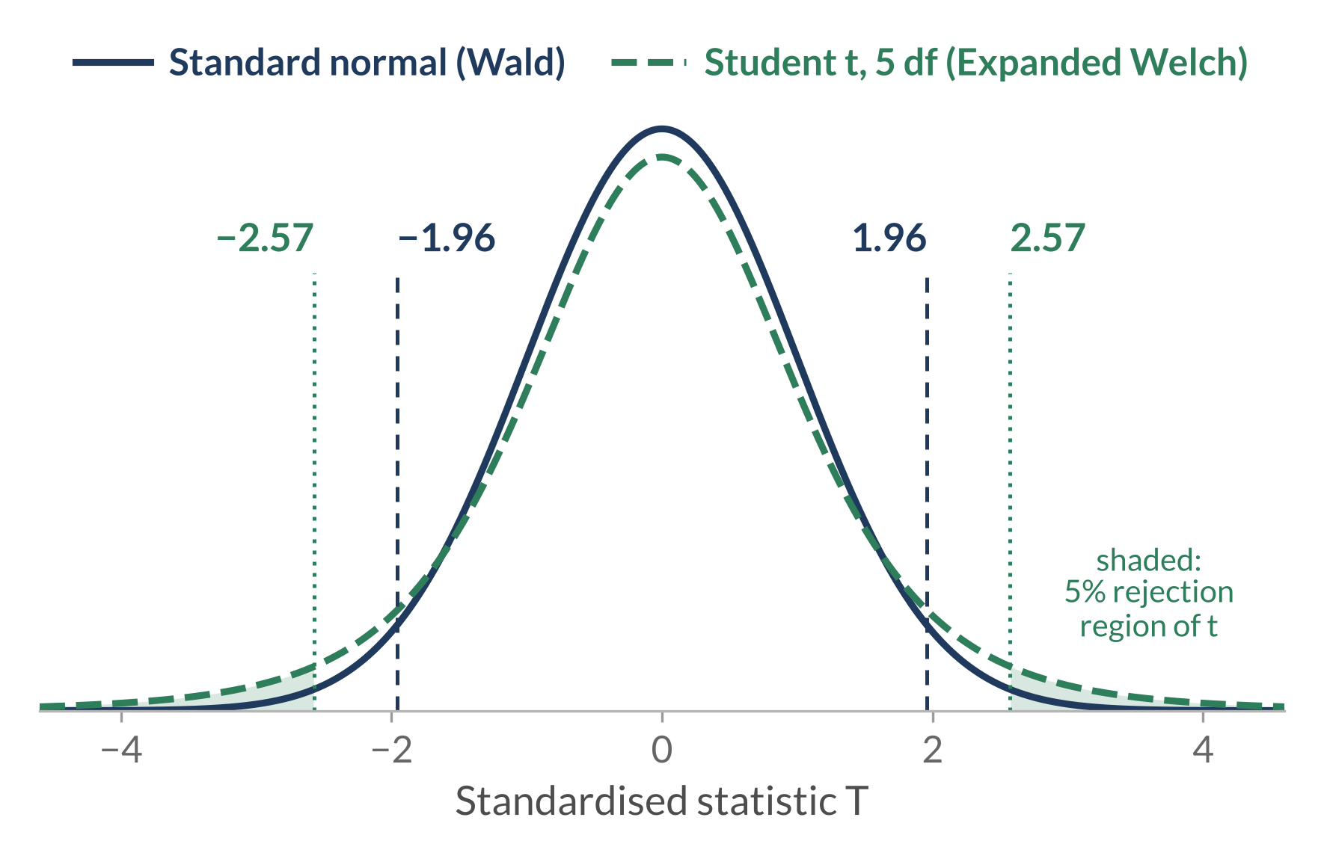

Method: one statistic, two reference distributions
Both methods use the same estimated MI difference and standard error.
Expanded Welch uses estimated degrees of freedom for a Student t distribution.
Shared statistic
$$T=\frac{{\hat{Δ}}_{BC}}{\hat{SE}}, {\hat{SE}}^{2}=\frac{\hat{V}\left(P\right)}{n_{P}}+\frac{\hat{V}\left(Q\right)}{n_{Q}}$$
${\hat{Δ}}_{BC}$: estimated 𝐼(𝑃) − 𝐼(𝑄), after leading bias correction.
$V\left(P\right)$: population variance of pointwise MI;
$\hat{V}\left(P\right)$ estimates it from one sampled table.
Wald test
Standard normal distribution; two-sided 5% cutoff about ±1.96.
Expanded Welch test
Student t distribution with estimated degrees of freedom; a larger cutoff.
Student t distribution with 5 degrees of freedom, for illustration; cutoff about ±2.57.
Thesis Chapters 3–4, Figure 2.1. Bias correction: Slide 15. Calculation requirements: Slides 6 and 22
4
Notes:
In the box on the left, both tests start with the estimated MI in P minus the estimated MI in Q. They correct for the leading bias and divide by the estimated standard error. For example, plus two means the corrected difference is two standard errors above zero. The two-sided test uses the distance from zero in either direction.
In the second equation, V-hat estimates the variance of pointwise MI, the information contribution of each category pair. Dividing V-hat by sample size estimates the sampling variance of MI. The samples are independent, so we add those two estimates to get the squared standard error.
In the blue box, the Wald test uses the standard normal distribution. At the 5% significance level, its cutoff is about 1.96 in either direction.
In the green box, the Expanded Welch test uses a Student t distribution as its reference. I estimate the degrees of freedom from the tables to account for how much the variance estimates can vary.
On the right, the dashed green curve shows a Student t distribution with five degrees of freedom. Its heavier tails put the 5% rejection region further out, past about 2.57 in either direction. Five is just for illustration. With more degrees of freedom, the cutoff gets closer to the Wald cutoff.
Since both tests use the same statistic and the Expanded Welch cutoff is larger, every Expanded Welch rejection is also a Wald rejection. So how do I choose the degrees of freedom that set that cutoff?

Slide 5
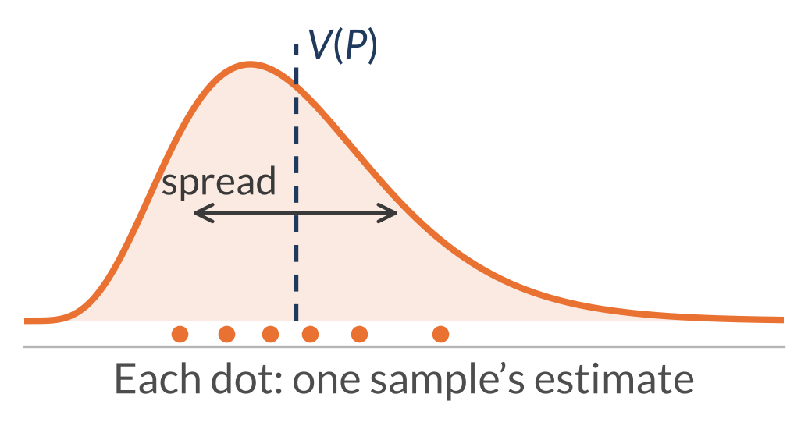
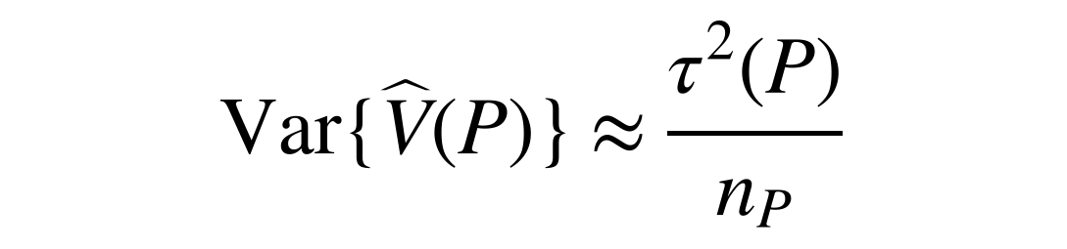
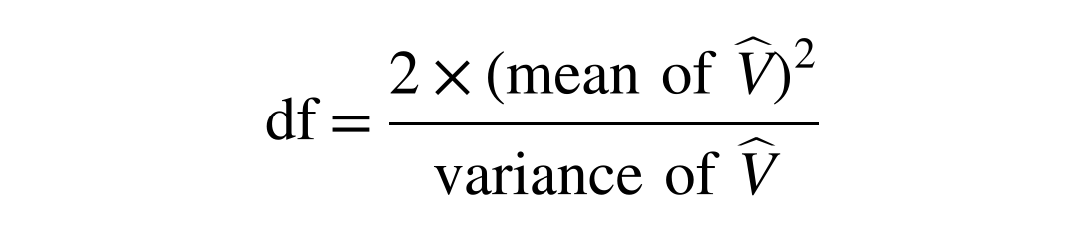
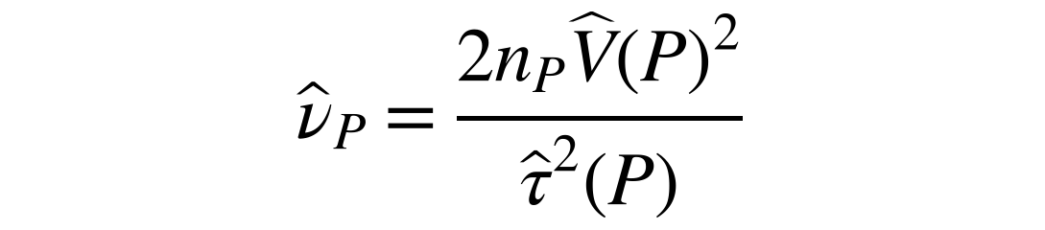
Approach and contributions
The estimated pointwise-MI variance changes between samples.
We approximate that variation and use it to choose the degrees of freedom.
1
$\hat{V}\left(P\right)$ varies between samples
2
Measure that variation
3
Turn it into degrees of freedom
$$Var\{\hat{V}\left(P\right)\}≈\frac{τ^{2}\left(P\right)}{n_{P}}$$
$$df=\frac{2×{\left(\text{mean of }\hat{V}\right)}^{2}}{\text{variance of }\hat{V}}$$
$${\hat{ν}}_{P}=\frac{2n_{P}\hat{V}{\left(P\right)}^{2}}{{\hat{τ}}^{2}\left(P\right)}$$
𝑔_{𝑃}(𝑥, 𝑦): how much 𝑉(𝑃) changes when a little probability moves to cell (𝑥, 𝑦)
𝜏²(𝑃): the variance of 𝑔_{𝑃}(𝑋, 𝑌)
More variation → fewer df → larger cutoff
Each new sample gives a new table, and so a new $\hat{V}\left(P\right)$.
Contribution 1: derivation
Contribution 2: test construction
Schematic, not data.
Approximation: first-order expansion
Approximation: moment matching
Then: repeat for Q and combine using Welch–Satterthwaite into one $\hat{ν}$ for the Student t cutoff. RQ1 checks both approximations (Slides 7–8).
Thesis Sections 4.1–4.3. Derivations of these equations: Slides 16–18; 𝑔 and 𝜏² in full, with a worked example: Slides 19–21
5
Notes:
Start with the orange panel on the left. Each dot in this sketch is a V-hat from a different sample of the same size. V-hat measures variation in pointwise MI within one sample. The spread of the dots is a second kind of variation: how much V-hat itself changes between samples. The dashed line marks the population value V.
To explain that spread, look at the middle panel. I start with one cell: if I move a little probability towards it, how quickly does V change? That shift changes the cell weights, the row and column totals, and the pointwise MI values that depend on them. I call that sensitivity g. Its sign tells us whether V initially rises or falls.
A random observation lands in one cell and picks out that cell's g. Tau-squared is the variance of g across observations from the population.
The first-order expansion keeps the linear effect of changes in the table, so the error in V-hat is approximately the average of the sensitivities in the sample. The sensitivities average to zero in the population, so the approximation centres V-hat at V. The observations are independent, so the variance of their average is tau-squared divided by sample size. That's the approximation at the top of the panel.
In the green panel, I use the mean and sampling variance of V-hat to choose degrees of freedom. Matching those two quantities to a scaled chi-squared distribution gives the first formula: twice the squared mean divided by the variance. For a given mean, more variation gives fewer degrees of freedom and a larger cutoff. The second formula uses V as the approximate mean and tau-squared over sample size as the approximate variance, with both inputs estimated from the table for P. That gives the component degrees of freedom, meaning the value for one population.
At the bottom, I repeat the calculation for Q and use the Welch–Satterthwaite rule to combine the two into the degrees of freedom for the Student t distribution. RQ1 checks both approximations.

Slide 6
Evaluation design
Known populations separate approximation accuracy, false positives, and power.
Both tests receive the same sampled table pairs.
Research questions
Shared simulation grid
Four sizes: 2×2, 4×4, 8×8, 16×16
Uniform, same-skew, and different-skew margins
Ten sample sizes: 10 to 50,000 observations per population
360 settings per study (4 sizes × 3 margins × 10 sample sizes × 3 MI levels or gaps)
100,000 independent table pairs per setting
Model: a copying construction that fixes the margins and solves for the target MI.
1
RQ1: Approximation accuracy
Sampling moments of $\hat{V}$ and component df, including near independence
2
RQ2: False positives
Equal MI at 0.005, 0.02, and 0.30 nats
3
RQ3: Power
𝐼(𝑃) = 0.02; MI-gap magnitudes 0.005, 0.01, and 0.02 nats
Reporting: usual 0.05 p-value thresholds. Unsuccessful calculations count as non-rejections; calculation success is reported separately.
Morris et al. (2019). Thesis Chapter 5, Tables 5.1–5.3; exact vectors, sample sizes, and requirements on Slide 22
6
Notes:
On the left are the three questions. RQ1 checks the approximations, including near zero MI. RQ2 checks false-positive rates when MI is equal, and RQ3 checks power. For the power study, I keep MI in P at 0.02 nats and give Q the higher value. MI is in nats because I use natural logarithms.
On the right, there are four table sizes, from two by two to sixteen by sixteen. The margin labels describe the category frequencies: uniform means equally frequent, same-skew means uneven in the same way in both populations, and different-skew means uneven in different ways. With ten sample sizes and three MI levels or gaps, that gives 360 settings per study for RQ2 and RQ3.
I draw 100,000 independent table pairs per setting. Both tests get the same pairs, so a difference in their decisions can't come from using different samples.
The model line shows how I set population MI. I draw X, then either copy its category into Y or draw Y independently from the same frequencies. I adjust the probability of copying to reach each target MI without changing the category frequencies.
At the bottom, both tests use a 5% significance level. If a calculation fails, I count it as a non-rejection and report calculation success separately.

Slide 7
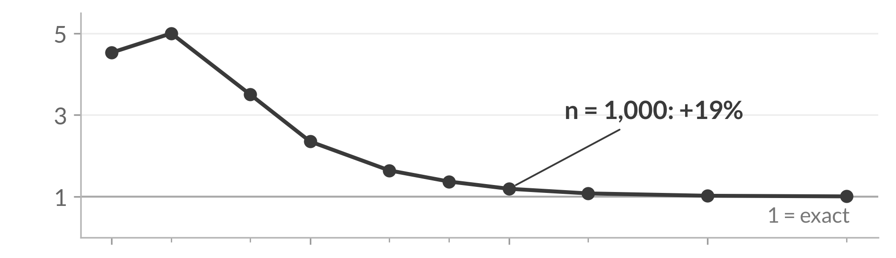
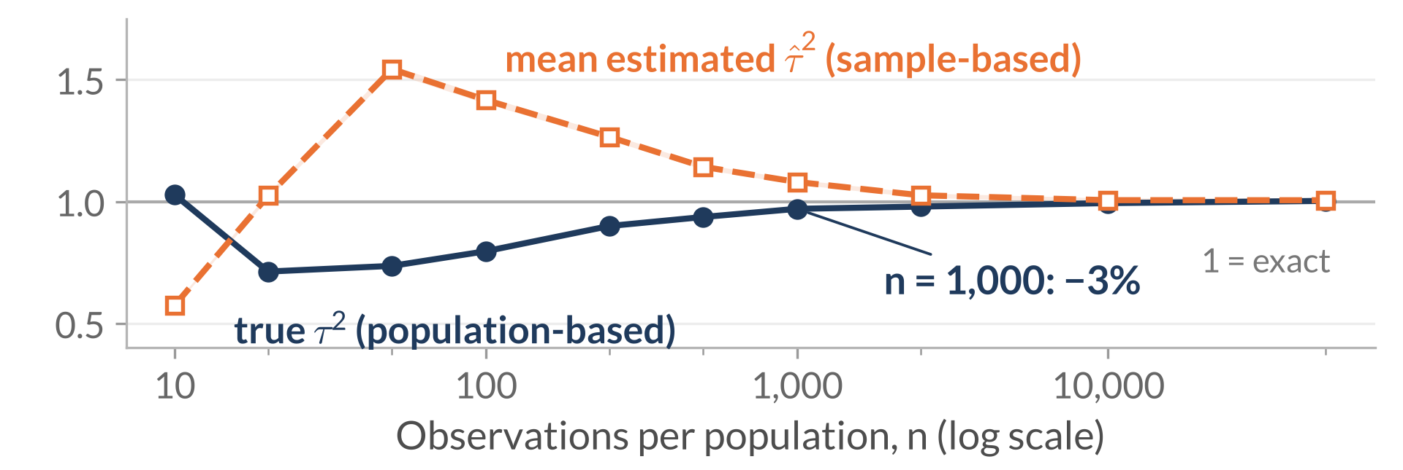
RQ1 results: approximation accuracy
The mean of $\hat{V}$ can remain inflated even when its population first-order sampling-variance prediction is accurate.
Mean check: $E\left(\hat{V}\right)$ ÷ $V$
Different-skew P · 4×4 · population MI 0.02 nats
Mean: rare cells can inflate it.
Newly observed rare cells can have large pointwise-MI deviations, whose squares raise $\hat{V}$.
Sampling variance:
linearisation can miss large changes.
Rare cells appear in some samples and not others;
sample-based sensitivities can also overpredict the resulting variation.
Variance check: $τ^{2}/n$ ÷ $Var\left(\hat{V}\right)$ predicted ÷ actual sampling variance
At n = 1,000: mean 19% high;
variance prediction 3% low with population-based inputs
and 8% high with sample-based inputs.
Both moments enter the degrees of freedom.
Thesis Sections 6.1.1–6.1.2, Figures 6.1–6.2. Bands: approximate 95% Monte Carlo intervals. Other sizes and Q: Slide 23; derivation: Slide 16
7
Notes:
Both graphs vary sample size. They show population P in a four-by-four, different-skew setting, with population MI of 0.02 nats.
The top graph divides average V-hat by population V. The ratio is well above one for small samples, so the first-order approximation gives too low a mean there. As sample size grows, the curve comes down towards one.
The box beside the top graph points to one reason. A rare category pair that appears in a sample can have a pointwise MI far from the table's MI. Squaring that gap can push V-hat up. Even at 1,000 observations, average V-hat is still 19% above V.
The lower graph divides the predicted sampling variance of V-hat by the variance observed across repeated samples. Below one means the prediction is too low, and above one means it's too high.
The solid navy curve uses the population tau-squared. Rare cells appearing in some samples but not others can produce changes larger than the linear approximation predicts. At the same sample size of 1,000, this prediction is about 3% low.
The dashed orange curve uses tau-squared estimated from each table, then averages the resulting predictions. Estimating sensitivities from sparse counts can instead overpredict the variation; at that sample size, the prediction is about 8% high.
Look at the summary at the bottom. The population inputs give us a fairly accurate prediction of the variance even though they give us too low a mean. Moment matching squares the mean, so using that lower value can push the degrees of freedom down.

Slide 8
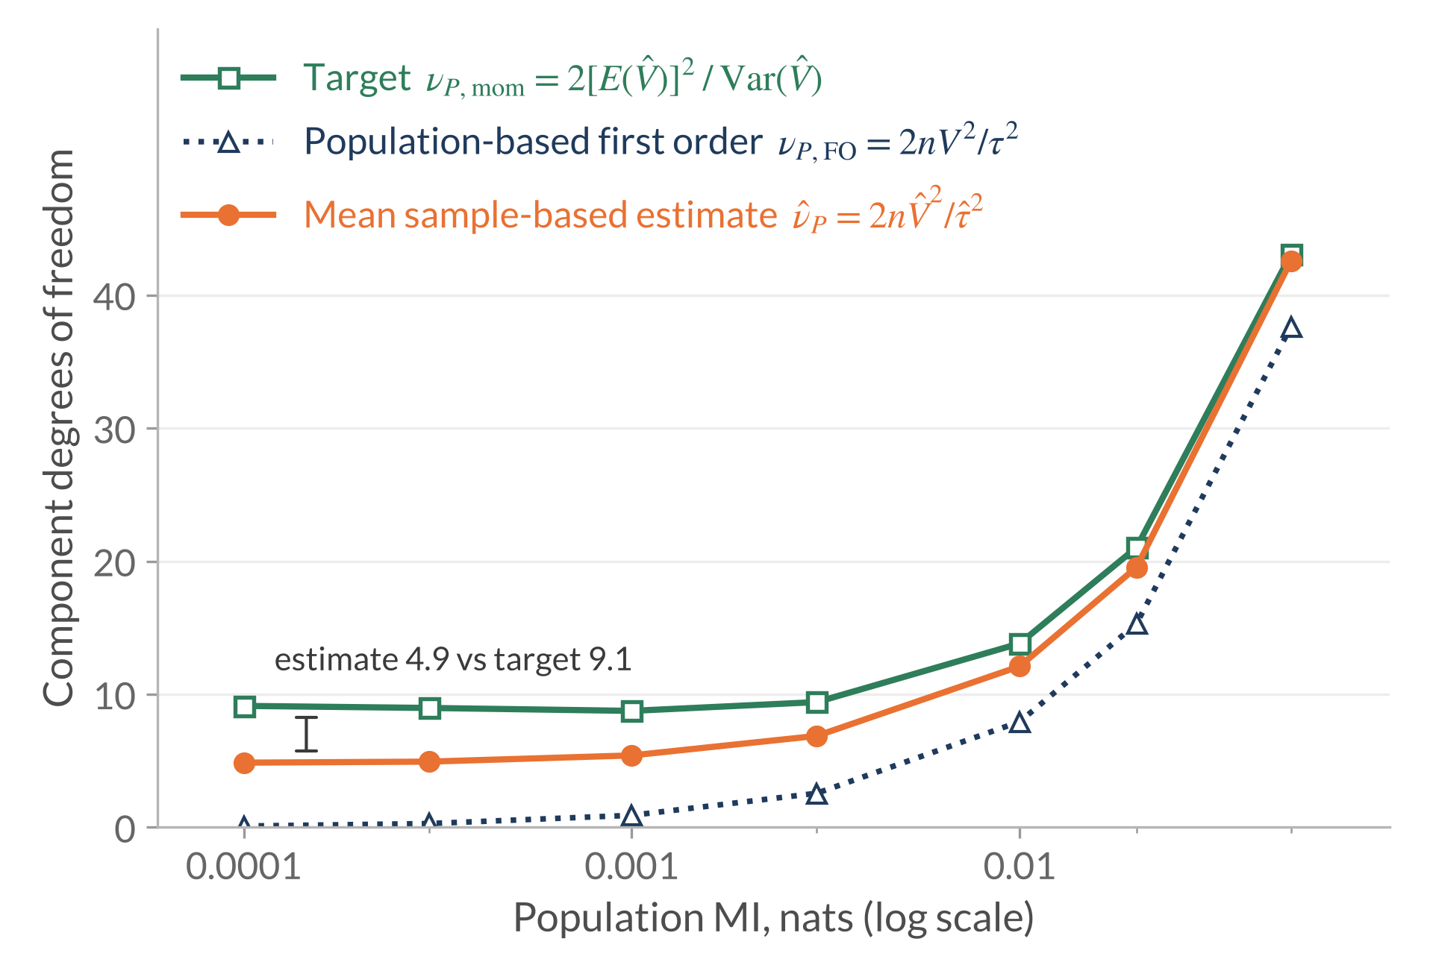
RQ1 results: near independence
Near independence, first-order theory gives almost no degrees of freedom, while
sampling noise keeps the mean sample-based estimate at about half the target.
Different-skew P · 4×4 · n = 1,000 fixed
Sample-based: noise keeps it near 5
Quadratic sampling errors create apparent association, which remains in each sample’s calculation.
Population-based: falls to about n × MI
Inserts known population inputs into the first-order formula. Near independence it is about n × population MI, which heads to zero.
At MI 0.0001: target ≈9.1;
mean sample-based estimate ≈4.9;
population-based value ≈0.1
Target: component degrees of freedom from the actual mean and variance of $\hat{V}$ across 100,000 samples.
Thesis Section 6.1.3, Figure 6.3; Appendix A.2. Bands: approximate 95% Monte Carlo intervals. Definitions of the three lines: Slide 18; local calculation: Slide 24
8
Notes:
Here the table size stays four by four and sample size stays at 1,000. We move left towards smaller population MI on the log scale and look at the component degrees of freedom on the vertical axis.
Start with the green line. It is the moment-matching target, calculated from V-hat's mean and variance across repeated samples. At the leftmost point, the target is about 9.1.
The dotted navy line uses known population inputs in the first-order formula, as explained in the navy box. Close to zero MI, this component value is approximately sample size times population MI, so it heads towards zero. At the same MI value it is about 0.1, far below the target.
The orange line averages the component degrees of freedom estimated from the sampled tables. As the orange box explains, at zero population MI the linear term in the uncorrected MI estimate vanishes, but squared probability errors can still make that estimate positive. The calculation from each table picks up that noise. The bracket shows the result: about 4.9, roughly half the target.
Hitting that target would still leave us with a question: how often do the tests reject when population MI is equal?

Slide 9
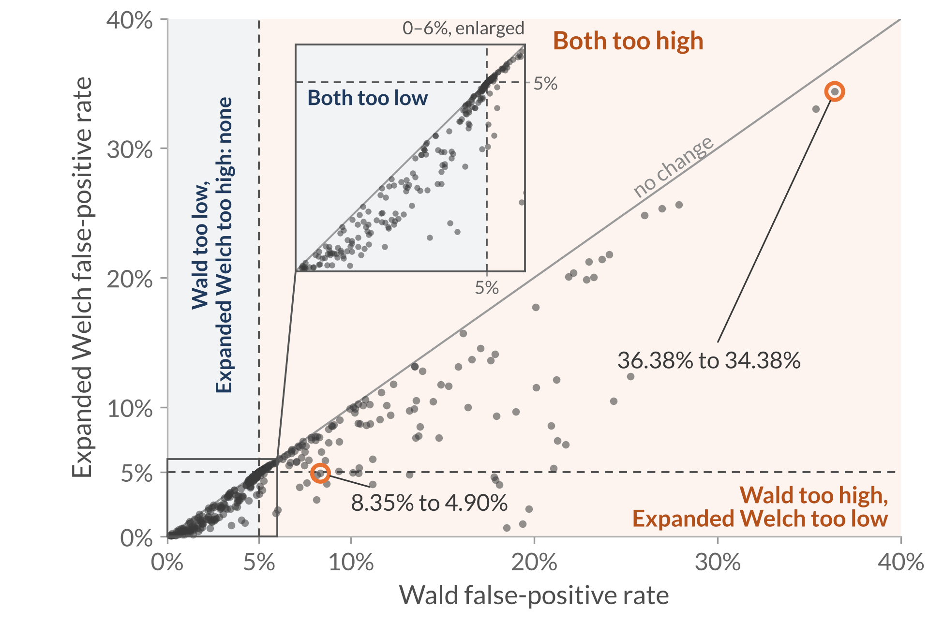
RQ2 results: false positives across all null settings
A larger cutoff helps only where Wald rejects too often;
where Wald already rejects too rarely, it never brings the rate closer to 5%.
All 360 null settings · equal MI in P and Q · each point is one setting
Wald too high: 178 settings
Expanded Welch moves closer to 5% in 165, for example 8.35% to 4.90% (uniform 4×4, n = 20, MI 0.02).
Wald too low: 180 settings
Further below 5% in 176 settings; unchanged in four.
Descriptive 4–6% band: 130 versus 136 settings.
Bias-driven excess persists: 36.38% to 34.38%
(different-skew 16×16, n = 1,000, MI 0.005).
Below the diagonal: Expanded Welch rejects less often.
Dashed lines: the 5% target.
Tallies of the thesis null study (Sections 6.2.1–6.2.3, Figures 6.4–6.6); two settings sit exactly at 5%. Full grids on Slides 25–27
9
Notes:
Each dot is one of the 360 equal-MI settings. The horizontal axis shows the Wald test's false-positive rate, and the vertical axis shows Expanded Welch's. The dashed lines mark 5%.
The diagonal means equal rejection rates. All points lie on or below it because Expanded Welch can only reduce rejection.
Start with the top box on the right. The Wald test is above 5% in 178 settings, and Expanded Welch gets closer to 5% in 165 of them. The highlighted uniform example goes from 8.35% to 4.90%.
In the next box, the Wald test is below 5% in 180 settings. Expanded Welch pushes the rate even lower in 176 of those and leaves four unchanged.
At the bottom right, the two tests land in the 4% to 6% band in roughly the same number of settings. Now look at the circled different-skew example near the top right of the plot. Here the shared MI is 0.005 nats. The false-positive rate falls from about 36% to about 34%, still far above 5%.
To see why a larger cutoff helps in some settings and does little in others, let's look at the estimated difference and its standard error.

Slide 10
RQ2 results: why the cutoff helps, hurts, or cannot fix it
Three kinds of estimation error explain the three patterns on Slide 9.
Three illustrative settings (thesis Table 6.1) · equal MI 0.02 nats · every calculation succeeds
Setting | Bias / SD | Variance ratio | Wald | Expanded Welch
Uniform 4×4, n = 20 | ≈0 | 0.83 | 8.35% | 4.90%
Same skew 16×16, n = 1,000 | ≈0 | 1.93 | 0.60% | 0.53%
Different skew 16×16, n = 1,000 | 2.06 | 1.94 | 26.01% | 24.84%
1
2
3
Bias / SD: shift of the estimated MI difference from zero, in sampling standard deviations. Variance ratio: average squared estimated standard error / observed variance.
Wald rejects too often. The larger cutoff offsets it: 8.35% to 4.90%.
Wald already rejects too rarely. The larger cutoff pushes it further below 5%.
The estimate sits about two SDs from zero. The larger cutoff barely helps: 26.01% to 24.84%.
1
Standard error too small
2
Standard error too big
3
Bias in the MI difference
Conclusion: A larger cutoff can offset a standard error that is too small, but it cannot fix bias in the estimated MI difference.
Thesis Section 6.2.4, Table 6.1. Bias correction: Slide 15. Full grids: Slides 25–27; ordinary Welch comparison: Slide 28
10
Notes:
All three rows use equal MI of 0.02 nats, and every calculation succeeds. The bias column shows how far the average estimated difference is from zero, in sampling standard deviations. In the next column, one means the average squared standard error matches the observed variance of the estimated difference.
In the uniform row, the biases cancel in expectation, so the difference is centred near zero. The variance ratio is below one, so the squared standard error is too small on average. For a given difference, a smaller standard error puts the statistic further from zero. Here the larger cutoff offsets that, bringing the false-positive rate from 8.35% to 4.90%.
In the same-skew row, the biases again cancel in expectation, but the variance ratio is nearly two. That overstatement of uncertainty helps explain why the Wald test rejects only about 0.6% of the time. The larger cutoff pushes it further below 5%, to about 0.5%.
The third row keeps the table size and sample size but uses different-skew margins. The variance ratio is still nearly two, but now the estimated difference averages about two sampling standard deviations above zero. The false-positive rate only falls from about 26% to about 25%. As the final box shows, changing the cutoff leaves that bias in place.
The takeaway at the bottom is that a larger cutoff can offset a standard error that's too small, but it leaves the bias in the estimated difference unchanged.

Slide 11
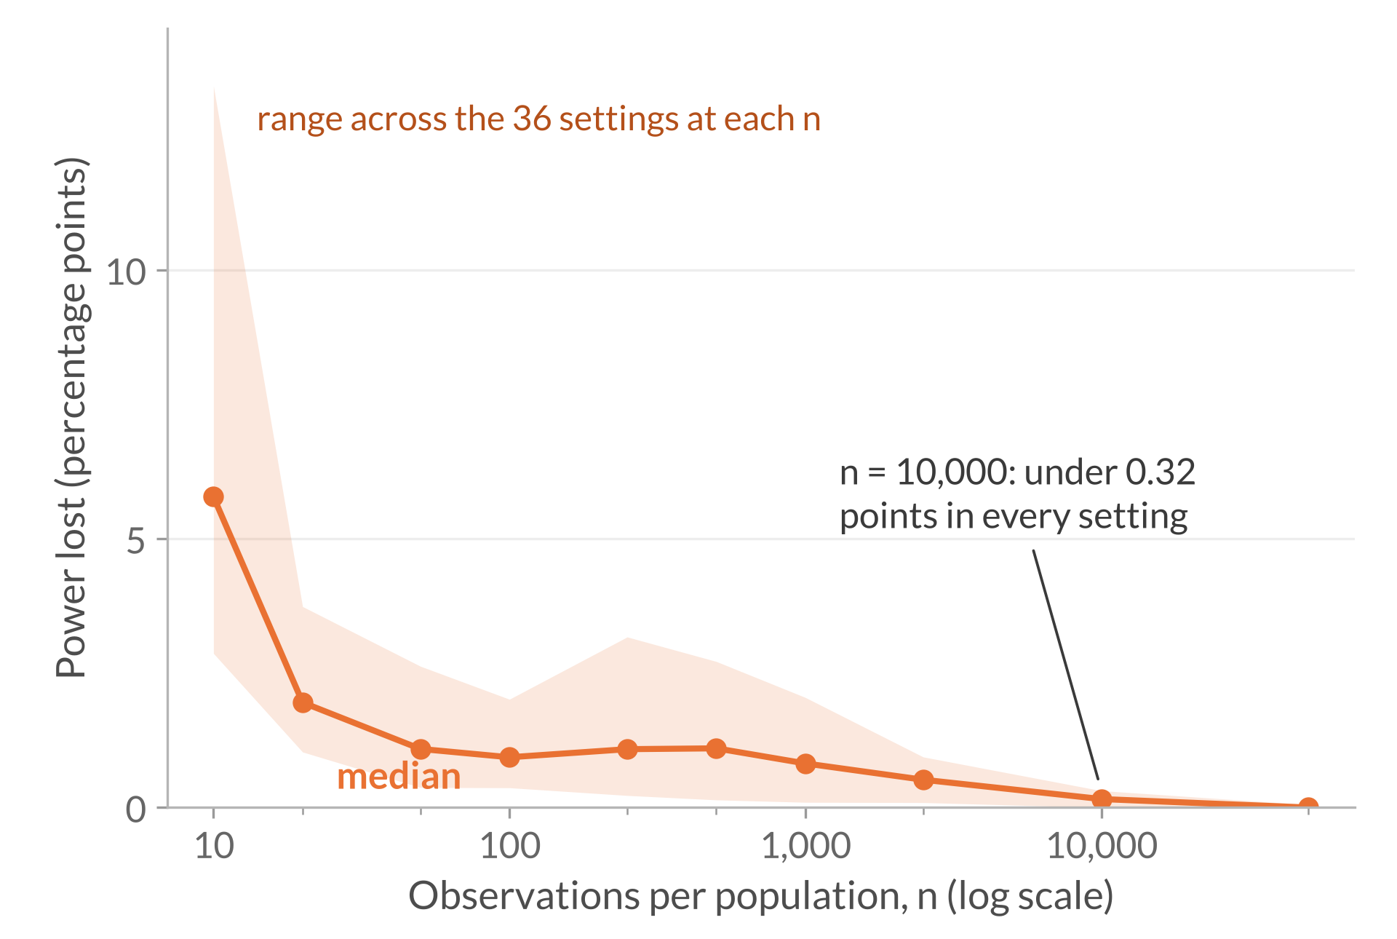
RQ3 results: the power cost of the larger cutoff
Expanded Welch never has more power than Wald;
the loss is largest in small samples and under 0.32 points by n = 10,000.
All 360 power settings · MI in P = 0.02 nats · gaps of 0.005, 0.01, and 0.02 nats
The loss is concentrated in small samples
Median loss: about 6 points at n = 10, about 1 point from n = 50 to 1,000, and 0.16 at n = 10,000. Failed calculations add to it at the smallest samples.
Small MI gaps can stay hard to detect
Even at n = 50,000, the 0.005 gap reaches only
79.87%–96.47% power; gaps of 0.01 and 0.02 exceed 99.9%.
Power: rejecting equal MI when population MI differs, in either direction, at the usual 0.05 threshold.
Power lost: Wald power minus Expanded Welch power, in percentage points.
Tallies of the thesis power study (Sections 6.3.1–6.3.3, Figures 6.7–6.9); unsuccessful calculations count as non-rejections. Full grids on Slides 29–31
11
Notes:
Power is the chance of detecting a real MI difference. This graph shows how many percentage points of power Expanded Welch loses compared with the Wald test. The line is the median loss across 36 settings at each sample size, and the shading shows the full range.
The upper-right box summarises the small-sample cost. With ten observations per population, the median loss is about six percentage points, partly because some calculations fail. From 50 to 1,000 observations, the median loss is about one point. By 10,000, even the largest loss is less than a third of a percentage point.
Both tests use a 5% significance level. Their actual false-positive rates can differ, so read the power results alongside those rates.
The lower-right box concerns absolute power. Even at 50,000 observations, the smallest MI gap of 0.005 nats gives Expanded Welch power of about 80% to 96%. Power is above 99.9% for the two larger gaps. So the two tests can have similar power and still miss some real differences when the MI gap is small.
At the bottom, notice that power counts rejections in either direction. Next, we'll see what happens to the estimated sign.

Slide 12
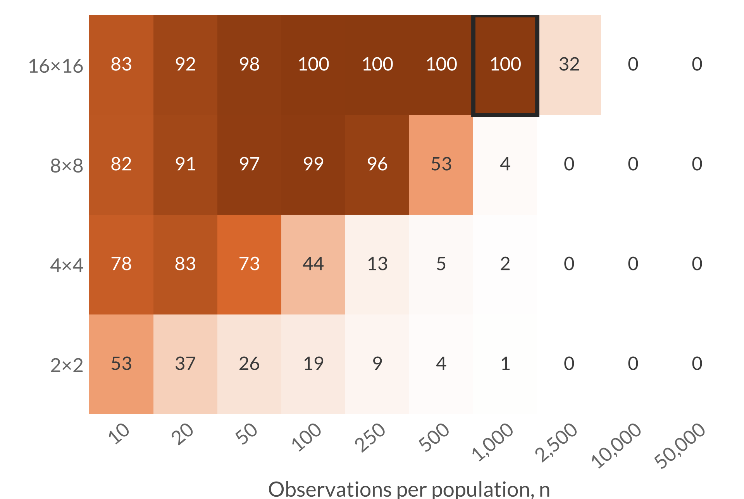
RQ3 results: bias can reverse the estimated direction
Under different-skew margins, sparse tables give rejections that point to the wrong population.
Different-skew margins · MI gap 0.01 nats · % of Expanded Welch rejections with the wrong sign
Outlined cell: 16×16, n = 1,000
True difference −0.0100 nats; mean estimate +0.0207. Expanded Welch rejects in 9.66% of repetitions, and over 99.9% of those point the wrong way.
Higher-order bias outweighs the gap
Leading term: 0.11 nats each; equal n cancels it
Higher-order bias: differs between P’s and Q’s margins, shifting the difference by +0.031 nats (3× the gap)
Fix: more data, not a larger cutoff
Across all 360 power settings, 28 have at least 90% of rejections pointing the wrong way. All 28 are 8×8 or 16×16 with different-skew margins.
Percentages are rounded.
A value of 50% means half the rejections have the wrong estimated sign.
Tallies of the thesis power-study diagnostics (Section 6.3.3, Figure 6.9); other gaps show the same pattern. Outlined cell: 9,659 of 9,662 rejections positive
12
Notes:
This heat map uses different category frequencies and an MI gap of 0.01 nats, with Q always having greater population MI. Rows show table sizes and columns show sample sizes.
Each cell shows the share of Expanded Welch rejections that point to the wrong population. So 50% means about half the rejections point to P as having higher MI.
The dark cells show that almost every rejection points the wrong way over parts of the sparse, larger-table range.
Look at the outlined sixteen-by-sixteen cell at 1,000 observations per population. Q truly has more MI, by 0.01 nats. On average, the estimate points the other way and puts P ahead by about 0.02 nats. Expanded Welch rejects in about 10% of repetitions. Almost every one of those rejections points to P as having higher MI.
The next box shows why. The table sizes and sample sizes match, so the two leading corrections cancel in the difference. But the remaining bias pulls Q's estimate down more than P's. That shifts the estimated difference up by about 0.03 nats, three times the true gap. The cutoff can't undo that shift. With 10,000 observations per population, fewer than 0.4% of rejections pointed the wrong way in every setting at that sample size.
At the bottom is the tally across all 360 power settings. In 28 settings, at least 90% of rejections point the wrong way. All 28 use different-skew margins with eight-by-eight or sixteen-by-sixteen tables. Those rejections still count towards two-sided power.

Slide 13
Conclusions and next steps
MI-specific degrees of freedom improve some false-positive rates, while remaining failures identify estimation accuracy as a priority.
Contributions
1
Derivation
How the estimated pointwise-MI variance varies between samples
2
Test construction
The Wald statistic with estimated Student t degrees of freedom
3
Empirical evaluation
Accuracy, false positives, power, and calculation success
Findings by research question
RQ1
Approximation accuracy
RQ2
False positives
RQ3
Power and direction
Approximations improve as samples grow; near independence, first-order theory misses sampling noise.
Helped only where Wald rejected too often; pushed conservative settings further below 5%.
At the same nominal 5% threshold, power is no higher; bias can make rejections point the wrong way.
Scope: The evaluation covers one population construction and equal sample sizes, with the Wald test as the main benchmark.
Next steps
Reduce bias in the estimated MI difference and improve its standard error and degrees of freedom, including near independence.
Test other association constructions and unequal sample sizes.
Thank you.
13
Notes:
Across the top are the three contributions. First, I derived how a change in the probability table affects pointwise-MI variance. Second, I used that result to choose degrees of freedom for the Student t distribution. Third, I evaluated the approximations and compared the tests in simulations.
In the next row, RQ1 shows that the approximations generally improve with sample size, but the first-order calculation misses sampling noise near zero MI.
For RQ2, the larger cutoff brings many excessive false-positive rates closer to 5%, but pushes them further below 5% when the Wald test already rejects too rarely.
For RQ3, Expanded Welch can't have higher power than the Wald test at the same 5% significance level. A large enough bias can also make rejections point to the wrong population.
These findings come from one way of constructing populations, equal sample sizes, and a comparison with the Wald test.
The first next step is to reduce bias in the estimated MI difference and improve its standard error and degrees of freedom, including when population MI is close to zero.
The second is to evaluate other population constructions and unequal sample sizes.
Overall, the cutoff adjustment helps in some settings, but reliable comparisons also require accurate estimates of the MI difference and its standard error.
Thank you.

Slide 14
Method (Slides 4–5)
RQ1 accuracy (Slides 7–8)
15 | Bias correction
16 | Derivation 1: variance of the estimate
17 | Derivation 2: moment matching
18 | Derivation 3: estimated and combined df
19 | Variance sensitivity in full
20 | Sensitivity in cell probabilities
21 | Worked example
23 | Ratios by table size
24 | Near-independence noise
Appendix
RQ2 null results (Slides 9–10)
25 | Uniform margins
26 | Same-skew margins
27 | Different-skew margins
28 | Ordinary Welch comparison
Backup slides for questions
Grouped in the order of the talk. To jump, type the slide number and press Enter. Type 13 to return to the conclusion.
Evaluation design (Slide 6)
22 | Populations, grid, requirements
RQ3 power results (Slides 11–12)
29 | Uniform margins
30 | Same-skew margins
31 | Different-skew margins
References
32 | MI and testing foundations
33 | Related methods, evaluation
14
Notes:
Questions and answer guides
1. What is your main contribution?
• I derived the MI-specific sensitivity of the pointwise-MI variance as the cell probabilities, margins, and log ratios change.
• That gives the sampling-variance approximation needed to estimate component degrees of freedom and combine them using the established Welch–Satterthwaite rule.
• I evaluated approximation accuracy, false positives, power, and calculation success. Keeping the same estimated difference and standard error as the Wald test lets me isolate the effect of changing the reference distribution.
2. What do V, g, and tau-squared actually mean?
• V measures variation in pointwise MI across outcomes. V-hat estimates it from one table, and V-hat divided by n estimates MI's sampling variance.
• g measures how sensitive V is to shifting probability towards a particular cell, including the resulting changes in the margins. Slide 20 gives the cell formulas, and Slide 21 works through an example.
• Tau-squared is the variance of those sensitivities across outcomes. The sampling variance of V-hat is approximately tau-squared divided by n; tau is the standard deviation of the sensitivities.
3. Where do the degrees of freedom come from, and is the Student t distribution exact?
• A scaled chi-squared distribution with mean m and degrees of freedom nu has variance 2m²/nu. Matching moments gives nu as twice the squared mean divided by the variance.
• Approximating those moments by V and tau-squared/n gives component degrees of freedom of about 2nV²/tau-squared. The test estimates the inputs from each table. Slides 16–18 walk through the sampling variance, moment matching, and the combined degrees of freedom.
• The Student t distribution is the reference distribution, an approximation under equal population MI. Matching moments does not establish independence between the estimated MI difference and the variance estimates.
4. Why does the approximation struggle when population MI is close to zero?
• When population MI is zero, all population pointwise-MI values are zero, and the first-order sampling terms for MI and V-hat vanish. Squared probability errors can still give a positive plug-in MI estimate.
• On Slide 8, the population first-order value is about 0.1, while the mean sample-based estimate is about 4.9 because its calculation retains positive estimated MI from sampling noise.
• The repeated-sample moment target is about 9.1. The calculation on Slide 24 includes the squared probability errors and helps explain the separation between the lines. That explanation does not establish an exact replacement test.
5. Why this simulation design, and why 100,000 repetitions?
• The copying model controls MI while preserving chosen category frequencies, giving known population truth. It represents one family of joint probability tables.
• The 360 null and 360 power settings vary table size, frequencies, sample size, and MI values to expose different estimation problems.
• Repetitions estimate performance precisely; they do not increase an individual test's sample size. Both methods receive the same sampled pairs for comparison.
6. Why does bias remain after your correction?
• With equal dimensions and sample sizes, the two leading bias corrections cancel exactly in the MI difference. Slide 15 shows the correction and why it cancels.
• Higher-order biases remain. Identical population tables have matching expected biases, but distinct tables can have unequal biases even when their MI values agree.
• The difference can therefore be shifted away from its true value. Raising the rejection cutoff does not remove that shift.
7. Why does Expanded Welch help in some settings and hurt in others?
• Its larger cutoff can compensate for excessive rejection: the uniform example moves from 8.35% to 4.90% under equal MI.
• Where uncertainty is overestimated and the Wald test already rejects too rarely, the larger cutoff lowers the false-positive rate further below 5%.
• Substantial difference bias can leave both tests unreliable. In the diagnostic different-skew example, both reject about a quarter of the time despite equal population MI.
8. If it loses power, is the comparison fair or the method useful?
• At the same 5% significance level, every Expanded Welch rejection is also a Wald rejection, so its power can only stay the same or fall.
• Reducing excessive false positives may justify some power loss, but reducing an already-low rate makes conservatism worse.
• The power comparison uses the tests' usual rules. Their actual false-positive rates can differ, so assess the power loss alongside the change in false positives.
9. What does the wrong-direction result mean?
• Population MI really differs, so these are rejections under an alternative. The error is that the estimated sign identifies the wrong population as having greater MI.
• In the highlighted example, the true difference is −0.01, but its estimated mean is about +0.0207 because the biases remaining after correction differ enough to outweigh the gap.
• Of 9,662 rejections, 9,659 point the wrong way. That is over 99.9% of the rejections. Two-sided power counts those rejections.
10. Why not use permutation or bootstrap instead?
• Simple group-label permutation requires exchangeability. Equal MI allows different joint distributions, so it does not supply that condition.
• Separate-sample bootstrapping is a candidate, but an ordinary empirical bootstrap cannot generate cells absent from the observed table, and estimation bias can remain.
• I did not conduct a full resampling comparison. The thesis cannot establish superiority over those alternatives.
11. What assumptions and calculation rules matter most?
• Observations are independent and identically distributed within each population, with independent samples, fixed, aligned categories, positive population cell probabilities, and positive V and tau-squared for the first-order construction.
• Positive population probabilities still allow empty sampled cells, which are retained. Successful calculations require a positive finite standard error and, for Expanded Welch, positive finite degrees of freedom.
• Failed calculations count as non-rejections, with success reported separately. They contribute to some small-sample power loss but do not explain the highlighted failures where every calculation succeeds.
12. What is your overall conclusion, and what would you improve next?
• Expanded Welch improves some excessive false-positive rates, but its larger cutoff also increases conservatism and can reduce power at the same 5% significance level.
• I would first improve the MI-difference and standard-error estimates, changing one at a time to identify what resolves the failures.
• Further work should retain additional sampling variation when population MI is close to zero and evaluate other population constructions and unequal sample sizes. There is no universal sample-size rule established here.

Slide 15
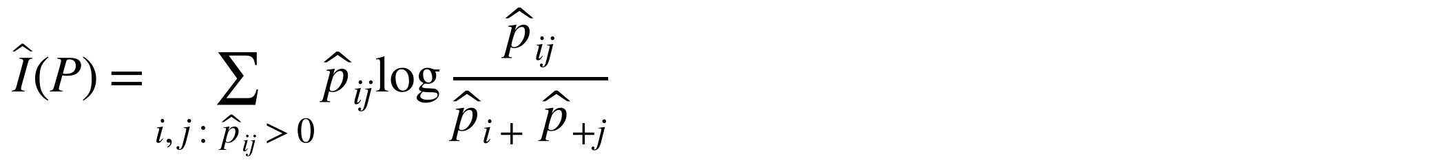
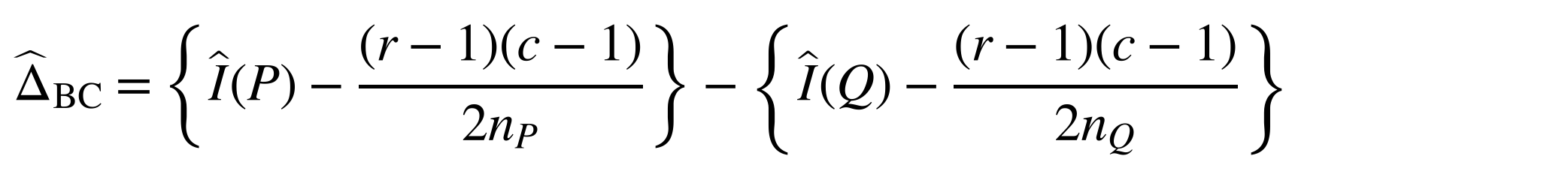
Bias correction
Appendix · Method · for Slide 4
The leading correction removes the 1/n bias from each estimate; with equal sample sizes it cancels from the difference
Plug-in estimate and its leading bias
Size of the leading term
16×16 at n = 1,000: 225/2,000 ≈ 0.11 nats per estimate, over five times the MI of 0.02.
𝐼𝑃=𝑖,𝑗: 𝑝𝑖𝑗>0​ 𝑝𝑖𝑗log𝑝𝑖𝑗𝑝𝑖+ 𝑝+𝑗
$$E\{\hat{I}\left(P\right)\}−I\left(P\right)=\frac{\left(r−1\right)\left(c−1\right)}{2n_{P}}+O\left(n_{P}^{−2}\right)$$
It cancels in these simulations
𝑛_{𝑃} = 𝑛_{𝑄} and the table sizes match, so ${\hat{Δ}}_{BC}$ equals the raw plug-in difference.
𝑟 and 𝑐 are the numbers of rows and columns. The bias is positive even when 𝑋 and 𝑌 are independent (Miller, 1955).
Bias-corrected difference
What remains
Higher-order bias, which depends on the whole table and can differ between P and Q. Different-skew 16×16, n = 1,000: true difference −0.01 nats, mean estimate +0.0207 (Slide 12).
$${\hat{Δ}}_{BC}=\left\{\hat{I}\left(P\right)−\frac{\left(r−1\right)\left(c−1\right)}{2n_{P}}\right\}−\left\{\hat{I}\left(Q\right)−\frac{\left(r−1\right)\left(c−1\right)}{2n_{Q}}\right\}$$
Without it, unequal sample sizes bias the difference: 0.005 nats for a 2×2 table with 𝑛_{𝑃} = 50 and 𝑛_{𝑄} = 100, at equal MI.
Beyond the leading term: Panzeri–Treves, the jackknife, Chao–Shen coverage, and NSB estimators (thesis Section 2.2.2).
Thesis Equations 2.7–2.9 and 3.7; Sections 2.2, 3.1.2 and 5.5. References: Slides 32–33
15
Notes:
Not part of the timed talk. Return to Slide 13 afterwards.
QUESTION ANSWERED
Which bias correction do you use, and why does it not remove the bias seen on Slides 10 and 12?
ANSWER TO GIVE
“Each MI estimate subtracts the leading bias, (r − 1)(c − 1) over 2n, which is Miller's correction. In every simulation the two samples have the same size and table dimensions, so the two corrections are equal and cancel from the difference. What remains is higher-order bias, which depends on the whole probability table. Distinct tables with equal MI can have different remaining biases, and that shifts the estimated difference, as on Slides 10 and 12. Reducing that bias is my first next step.”
NOTES
The leading term is 0.1125 nats per estimate for 16×16 at n = 1,000, and 0.225 nats for 4×4 at n = 20. With unequal sample sizes, the correction removes the leading unequal-sample bias; its performance there is untested (thesis Section 7.2). Corrected estimates can be negative and are retained. Empty sampled cells contribute nothing to the plug-in sum.
SOURCE
Thesis Equations 2.7–2.9 and 3.7; Sections 2.2, 3.1.2, 5.5 and 7.2; Miller (1955); Panzeri and Treves (1996); Paninski (2003); Chao and Shen (2003); Nemenman et al. (2002).

Slide 16
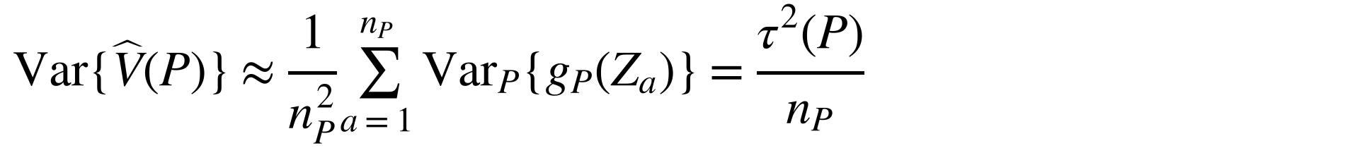
Derivation 1 of 3: how much the variance estimate varies
Appendix · Method · for Slide 5, step 2
A first-order expansion of $\hat{V}\left(P\right)$ = 𝑉($\hat{P}$) around the population table 𝑃
Write the sample table as an average of one-observation tables
$$\hat{P}−P=\frac{1}{n_{P}}\sum_{a=1}^{n_{P}}{ }\left(δ_{Z_{a}}−P\right)$$
Eq. 4.30
1
$$δ_{Z_{a}}: \text{all probability on the cell of observation }a$$
Expand 𝑉 to first order along the line from 𝑃 to $\hat{P}$
$$\hat{V}\left(P\right)−V\left(P\right)=V\left(\hat{P}\right)−V\left(P\right)≈\frac{d}{dt}V\{P+t\left(\hat{P}−P\right)\} at t=0$$
Section 4.3.1
2
The derivative is linear in the table change, so it splits into one term per observation
$$\hat{V}\left(P\right)−V\left(P\right)≈\frac{1}{n_{P}}\sum_{a=1}^{n_{P}}{ }g_{P}\left(Z_{a}\right)$$
Eqs. 4.10, 4.11, 4.31
3
$$g_{P}\left(x,y\right)=\frac{d}{dε}V\left(P_{ε}\right) at ε=0, P_{ε}=\left(1−ε\right)P+εδ_{\left(x,y\right)}$$
4
The sensitivities average to zero, so the mean is 𝑉(𝑃) to first order
$$E_{P}\{g_{P}\left(X,Y\right)\}=0 ⇒ E\{\hat{V}\left(P\right)\}≈V\left(P\right)$$
Eq. 4.35
Observations are independent, so the variances of the terms add
$$Var\{\hat{V}\left(P\right)\}≈\frac{1}{n_{P}^{2}}\sum_{a=1}^{n_{P}}{ }{Var}_{P}\{g_{P}\left(Z_{a}\right)\}=\frac{τ^{2}\left(P\right)}{n_{P}}$$
Eqs. 4.36–4.38
5
$$τ^{2}\left(P\right)={Var}_{P}\{g_{P}\left(X,Y\right)\}$$
Result: Slide 5, step 2
$$E\{\hat{V}\left(P\right)\}≈V\left(P\right), Var\{\hat{V}\left(P\right)\}≈\frac{τ^{2}\left(P\right)}{n_{P}}$$
First order: drops terms quadratic in the cell errors and needs positive cell probabilities. Slide 7 checks both approximations; 𝑔 in full: Slides 19–20.
Thesis Sections 4.2.1, 4.3.1 and 4.3.2
16
Notes:
Not part of the timed talk. Return to Slide 13 afterwards.
QUESTION ANSWERED
Where does Var{V-hat(P)} ≈ tau-squared(P)/n_P come from?
ANSWER TO GIVE
“V-hat is V evaluated at the sample table, and the sample table is an average of one-observation tables. A first-order expansion is linear in the table change, so the error in V-hat becomes an average of one sensitivity per observation. The sensitivities average to zero, so V-hat is centred on V to first order. Because the observations are independent, the variance of that average is the variance of one sensitivity, tau-squared, divided by n.”
NOTES
The expansion follows the straight line P + t(P-hat − P) from t = 0 to t = 1; the omitted terms are quadratic or higher in the cell-probability errors. The derivative of an average table change is the average of the one-observation derivatives because the linear term has fixed coefficients at P (thesis Section 4.3.1, citing van der Vaart, 1998, Chapter 20). Any bias in V-hat comes from terms beyond this linear approximation. Slide 7 shows both checks: the mean of V-hat over V, and the predicted over the observed variance.
SOURCE
Thesis Sections 4.2.1, 4.3.1 and 4.3.2; Equations 4.10, 4.11, 4.30, 4.31 and 4.35–4.38.

Slide 17
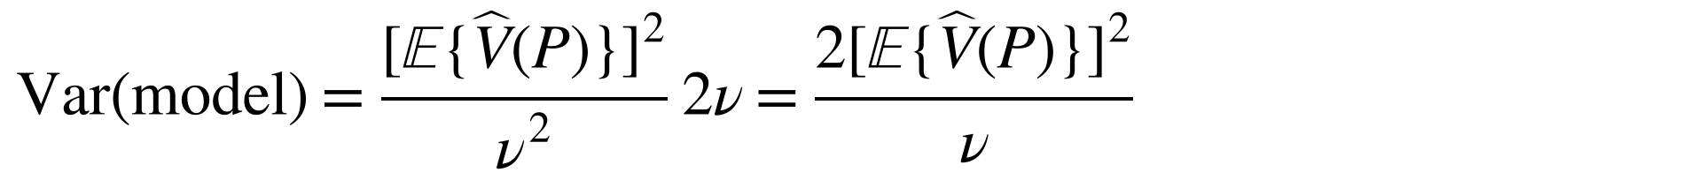
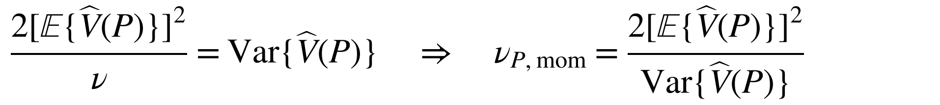
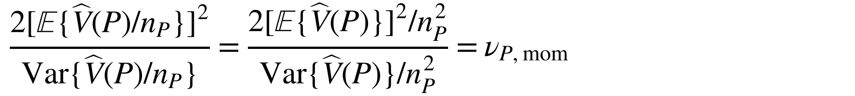
Derivation 2 of 3: moment matching gives the df rule
Appendix · Method · for Slide 5, step 3
Satterthwaite (1946): give $\hat{V}\left(P\right)$ a scaled chi-squared distribution with the same mean and variance
Model the estimate as a scaled
chi-squared variable with 𝜈 degrees
of freedom
$$\hat{V}\left(P\right) \dot{∼} E\{\hat{V}\left(P\right)\} \frac{χ_{ν}^{2}}{ν}$$
Eq. 4.2
1
Use the chi-squared moments; the model’s mean then matches for any 𝜈
$$E\left(χ_{ν}^{2}\right)=ν, Var\left(χ_{ν}^{2}\right)=2ν ⇒ E\left(model\right)=E\{\hat{V}\left(P\right)\}$$
Eqs. 4.3–4.4
2
Its variance depends on 𝜈
$$Var\left(model\right)=\frac{{\left[E\{\hat{V}\left(P\right)\}\right]}^{2}}{ν^{2}} 2ν=\frac{2{\left[E\{\hat{V}\left(P\right)\}\right]}^{2}}{ν}$$
Eqs. 4.5–4.6
3
Set it equal to the actual variance and solve for 𝜈
$$\frac{2{\left[E\{\hat{V}\left(P\right)\}\right]}^{2}}{ν}=Var\{\hat{V}\left(P\right)\} ⇒ ν_{P,mom}=\frac{2{\left[E\{\hat{V}\left(P\right)\}\right]}^{2}}{Var\{\hat{V}\left(P\right)\}}$$
Eq. 4.7
4
The test divides by the fixed 𝑛_{𝑃};
the factor cancels
$$\frac{2{\left[E\{\hat{V}\left(P\right)/n_{P}\}\right]}^{2}}{Var\{\hat{V}\left(P\right)/n_{P}\}}=\frac{2{\left[E\{\hat{V}\left(P\right)\}\right]}^{2}/n_{P}^{2}}{Var\{\hat{V}\left(P\right)\}/n_{P}^{2}}=ν_{P,mom}$$
Section 4.1.2
5
Result: the df rule on Slide 5, step 3
$$df=\frac{2×{\left(\text{mean of }\hat{V}\right)}^{2}}{\text{variance of }\hat{V}}=ν_{P,mom}$$
Check: for normal data, 𝑠² is exactly $σ^{2}χ_{n−1}^{2}/\left(n−1\right)$, so the rule gives ordinary Welch’s 𝑛 − 1 (Slide 28).
Moment matching motivates the Student t reference. It does not establish the standard normal numerator, or its independence from the variance estimates.
Satterthwaite (1946). Thesis Section 4.1.2
17
Notes:
Not part of the timed talk. Return to Slide 13 afterwards.
QUESTION ANSWERED
Why are the component df twice the squared mean over the variance, and why does dividing by n_P not change them?
ANSWER TO GIVE
“A variable with a scaled chi-squared distribution has variance twice its squared mean divided by its degrees of freedom. Matching those two moments to V-hat gives the target. Dividing V-hat by the fixed sample size rescales the squared mean and the variance equally, so the target is unchanged. For a normal sample variance the same rule gives n minus one, which is ordinary Welch. The resulting Student t distribution is still an approximation that needs empirical checking.”
NOTES
For a generic variance estimate U modelled as c times a variable with a chi-squared distribution on ν degrees of freedom, E(U) = cν and Var(U) = 2c²ν, giving ν = 2[E(U)]²/Var(U). Scaling by fixed n leaves this ratio unchanged.
SOURCE
Thesis Section 4.1.2, Equations 4.2–4.7; Satterthwaite (1946).

Slide 18
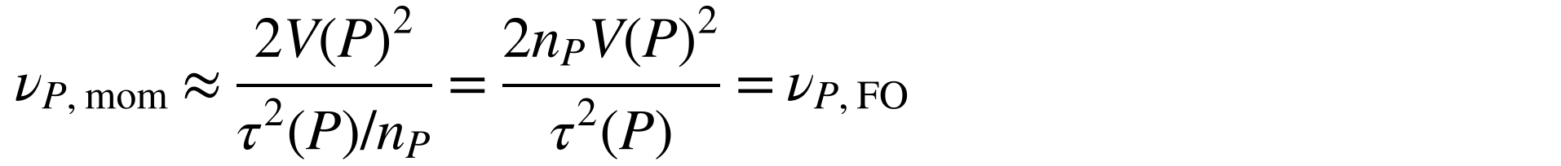
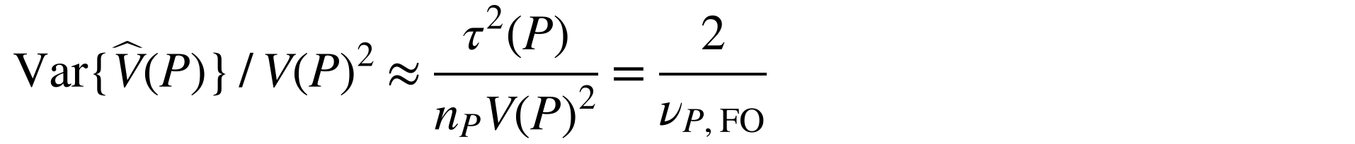
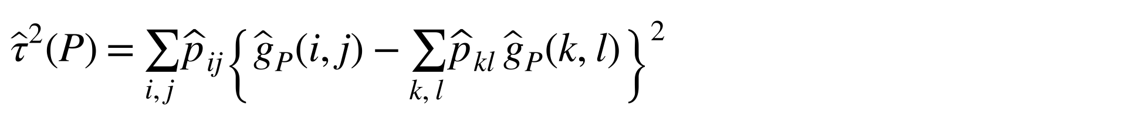
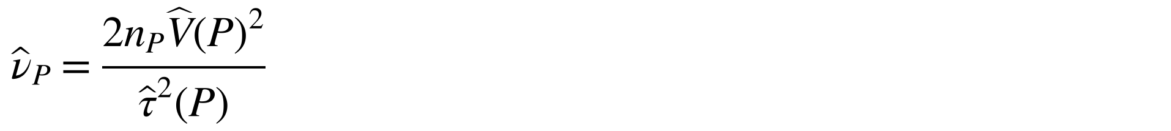
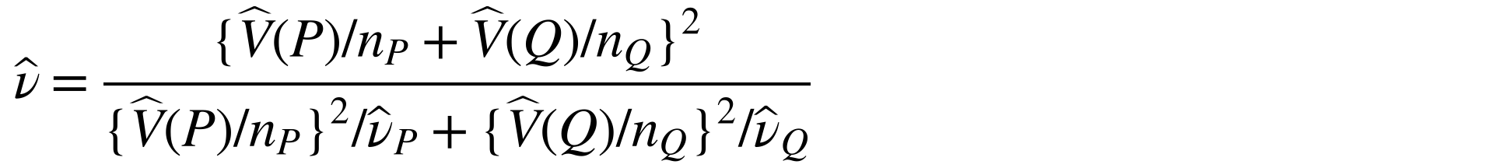
Derivation 3 of 3: estimated and combined degrees of freedom
Appendix · Method · for Slide 5, step 3
Put Derivation 1 into Derivation 2, estimate the inputs from one table, then combine 𝑃 and 𝑄
Substitute the first-order mean and variance from Derivation 1
$$ν_{P,mom}≈\frac{2V{\left(P\right)}^{2}}{τ^{2}\left(P\right)/n_{P}}=\frac{2n_{P}V{\left(P\right)}^{2}}{τ^{2}\left(P\right)}=ν_{P,FO}$$
Eq. 4.39
1
Read it as two over the relative variance: more variation, fewer df
$$Var\{\hat{V}\left(P\right)\} / V{\left(P\right)}^{2}≈\frac{τ^{2}\left(P\right)}{n_{P}V{\left(P\right)}^{2}}=\frac{2}{ν_{P,FO}}$$
Eq. 4.40
2
Estimate the inputs from the table, over occupied cells (cell forms: Slide 20)
𝜏2𝑃=𝑖,𝑗​ 𝑝𝑖𝑗𝑔𝑃𝑖,𝑗−𝑘,𝑙​ 𝑝𝑘𝑙 𝑔𝑃𝑘,𝑙2
Eqs. 4.41–4.42
3
Plug in to get the component estimate; the same for 𝑄
$${\hat{ν}}_{P}=\frac{2n_{P}\hat{V}{\left(P\right)}^{2}}{{\hat{τ}}^{2}\left(P\right)}$$
Eq. 4.43
4
Combine: moment-match the squared standard error. The samples are independent, so means and variances add
$${\hat{SE}}^{2}=\frac{\hat{V}\left(P\right)}{n_{P}}+\frac{\hat{V}\left(Q\right)}{n_{Q}}$$
Eq. 4.44
5
$$\hat{ν}=\frac{\{\hat{V}\left(P\right)/n_{P}+\hat{V}\left(Q\right)/n_{Q}\}^{2}}{\{\hat{V}\left(P\right)/n_{P}\}^{2}/{\hat{ν}}_{P}+\{\hat{V}\left(Q\right)/n_{Q}\}^{2}/{\hat{ν}}_{Q}}$$
${\hat{ν}}_{P}$: estimate used by the test
$\hat{V}\left(P\right)$, ${\hat{τ}}^{2}\left(P\right)$, and 𝑛_{𝑃} from one table
$ν_{P,FO}$: population, first order
𝑉(𝑃), 𝜏²(𝑃), and 𝑛_{𝑃}
$ν_{P,mom}$: target
Sampling mean and variance of $\hat{V}\left(P\right)$
Slide 8 compares all three. Requires 𝜏²(P) > 0 (Assumption 5). Thesis Sections 4.3.3–4.3.4, Table 4.1
18
Notes:
Not part of the timed talk. Return to Slide 13 afterwards.
QUESTION ANSWERED
How do the moments become the formula used in the test, and how are P and Q combined?
ANSWER TO GIVE
“Putting the first-order mean and variance into the moment-matching rule gives two n V-squared over tau-squared. That is two divided by the relative variance of V-hat, so more relative variation gives fewer degrees of freedom. The test replaces V and tau-squared by their table estimates, which gives nu-hat for P, and the same for Q. To combine them, I apply moment matching once more to the squared standard error. The samples are independent, so the variances add, which gives the Welch–Satterthwaite formula.”
NOTES
For the Slide 7 example at n = 1,000, the first-order component df are 15.30 against the moment target 21.03: approximately (1/1.19)²/0.97 = 0.73. The squared mean enters the target, so the mean ratio matters twice. Positive V does not guarantee positive tau-squared; a zero component is not an ordinary finite df.
SOURCE
Thesis Sections 4.3.3–4.3.4, Equations 4.39–4.44 and Table 4.1; Satterthwaite (1946); Welch (1947).

Slide 19
Variance sensitivity in full
Appendix · Method · detail for Slide 16
Perturbation towards one cell:
$$P_{ε}=\left(1−ε\right)P+εδ_{\left(x,y\right)}$$
Changing probability weights
$$g_{P}\left(x,y\right)=\{ℓ_{P}\left(x,y\right)−I\left(P\right)\}^{2}−V\left(P\right)$$
Changing pointwise-MI values and margins
$$+2[ℓ_{P}\left(x,y\right)−E_{P}\{ℓ_{P}\left(X,Y\right)∣X=x\}$$
$$−E_{P}\{ℓ_{P}\left(X,Y\right)∣Y=y\}+I\left(P\right)]$$
Pointwise MI:
$$ℓ_{P}\left(i,j\right)=log\{p_{ij}/\left(p_{i+}p_{+j}\right)\}$$
Sensitivity variance:
$$τ^{2}\left(P\right)={Var}_{P}\{g_{P}\left(X,Y\right)\}$$
Exact for positive population tables; its use for sampling errors is first order. Thesis Chapter 4
19
Notes:
Not part of the timed talk. Return to Slide 13 afterwards.
QUESTION ANSWERED
What exactly did you differentiate, and where do the margin terms enter?
ANSWER TO GIVE
“I differentiate the pointwise-MI variance along a one-observation perturbation. The first part changes the probability weights. The bracket also changes the log ratios, including their row and column margins. Both contributions are necessary because the pointwise-MI values themselves depend on the table.”
NOTES
Assumptions: fixed categories, independent observations within each sample, independent samples, positive population cell probabilities, and positive V and tau-squared for the first-order degrees-of-freedom construction. With every cell positive, positive MI is equivalent to positive V (Appendix A.3), but positive V does not guarantee positive tau-squared. A zero component is not an ordinary finite degrees-of-freedom value.
SOURCE
Thesis Chapter 4: perturbation path (eq:contamination-path), final form of g (eq:g-final), and definition of tau-squared (eq:tau-definition). This derivative is exact for positive population tables. Its use for sampling errors is first order.

Slide 20
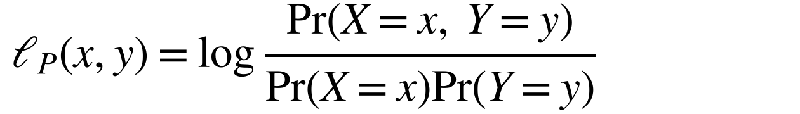
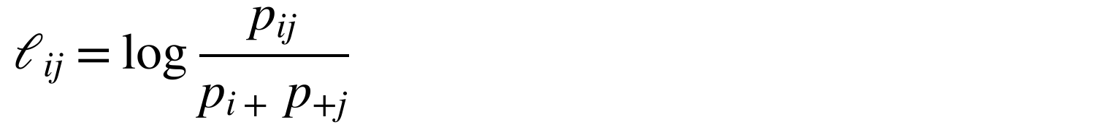
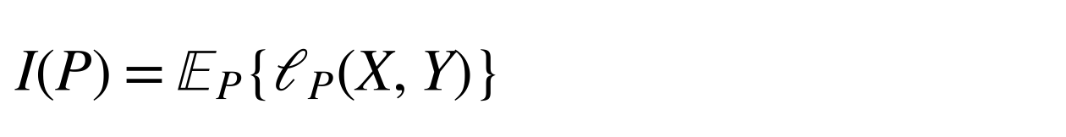
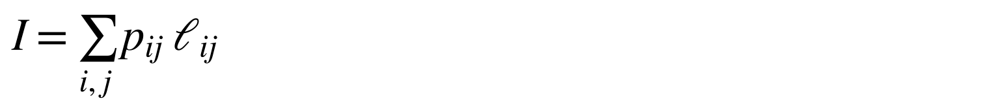
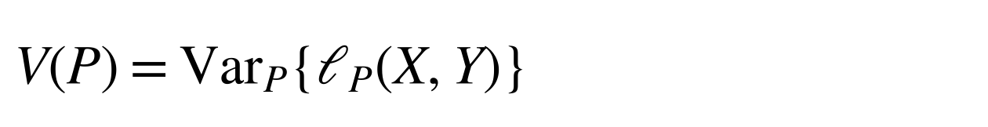
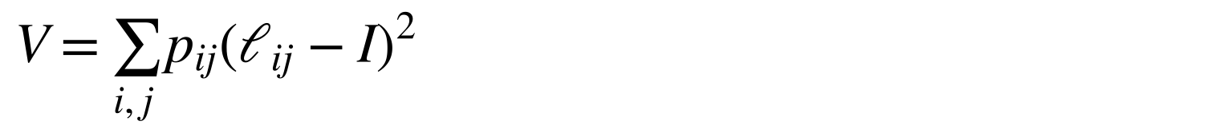
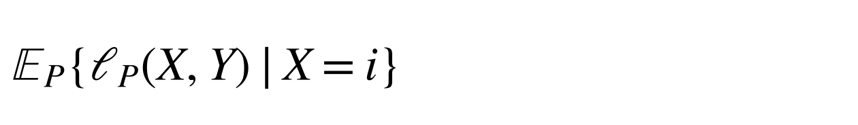
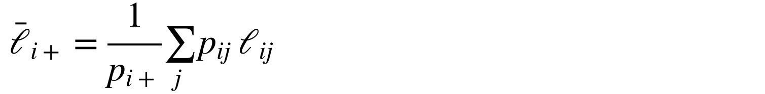
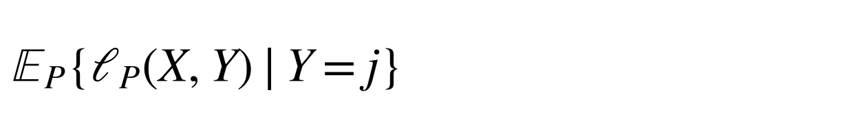
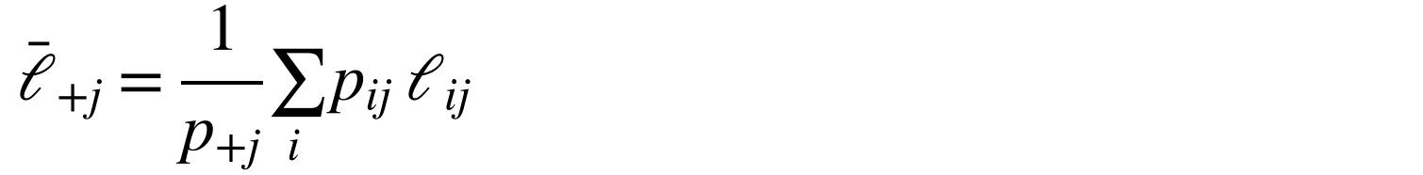
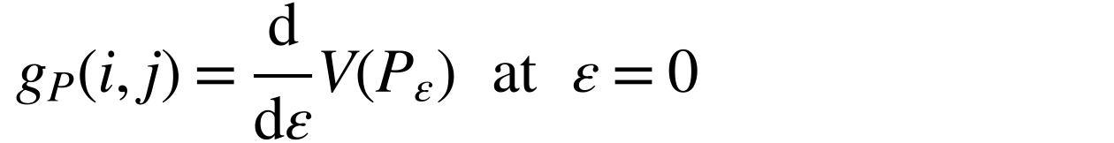
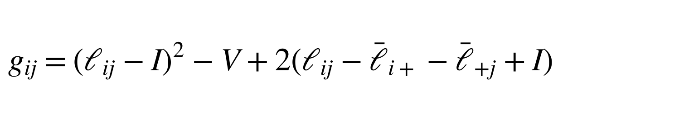
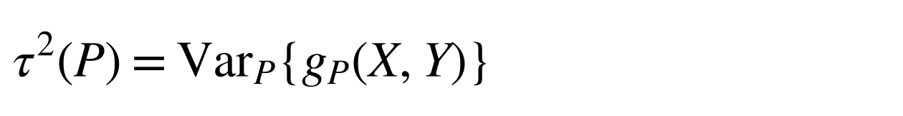
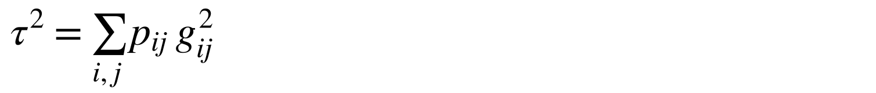
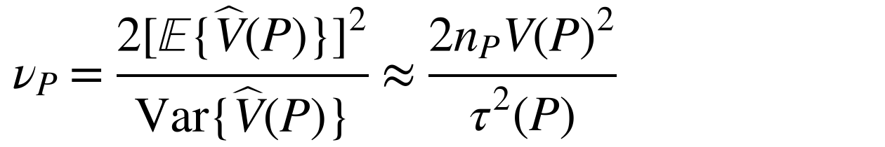
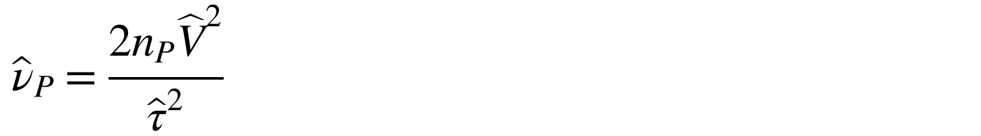
Variance sensitivity in cell probabilities
Appendix · Method · detail for Slide 16
Each quantity as an expectation, variance, or derivative, and as a sum over the cells of one table
Quantity
Definition
In cell probabilities
Pointwise MI
$$ℓ_{P}\left(x,y\right)=log\frac{Pr\left(X=x, Y=y\right)}{Pr\left(X=x\right)Pr\left(Y=y\right)}$$
$$ℓ_{ij}=log\frac{p_{ij}}{p_{i+} p_{+j}}$$
MI
$$I\left(P\right)=E_{P}\{ℓ_{P}\left(X,Y\right)\}$$
𝐼=𝑖,𝑗​ 𝑝𝑖𝑗 ℓ𝑖𝑗
Variance of pointwise MI
$$V\left(P\right)={Var}_{P}\{ℓ_{P}\left(X,Y\right)\}$$
𝑉=𝑖,𝑗​ 𝑝𝑖𝑗ℓ𝑖𝑗−𝐼2
Row mean of pointwise MI
$$E_{P}\{ℓ_{P}\left(X,Y\right)∣X=i\}$$
ℓ𝑖+=1𝑝𝑖+𝑗​ 𝑝𝑖𝑗 ℓ𝑖𝑗
Column mean of pointwise MI
$$E_{P}\{ℓ_{P}\left(X,Y\right)∣Y=j\}$$
ℓ+𝑗=1𝑝+𝑗𝑖​ 𝑝𝑖𝑗 ℓ𝑖𝑗
Sensitivity of V to cell (i, j)
$$g_{P}\left(i,j\right)=\frac{d}{dε}V\left(P_{ε}\right) at ε=0$$
$$g_{ij}={\left(ℓ_{ij}−I\right)}^{2}−V+2\left(ℓ_{ij}−{\overset{‾}{ℓ}}_{i+}−{\overset{‾}{ℓ}}_{+j}+I\right)$$
$$P_{ε}=\left(1−ε\right)P+εδ_{\left(i,j\right)}$$
Variance of the sensitivities
$$τ^{2}\left(P\right)={Var}_{P}\{g_{P}\left(X,Y\right)\}$$
𝜏2=𝑖,𝑗​ 𝑝𝑖𝑗 𝑔𝑖𝑗2
Component degrees of freedom
$$ν_{P}=\frac{2{\left[E\{\hat{V}\left(P\right)\}\right]}^{2}}{Var\{\hat{V}\left(P\right)\}}≈\frac{2n_{P}V{\left(P\right)}^{2}}{τ^{2}\left(P\right)}$$
$${\hat{ν}}_{P}=\frac{2n_{P}{\hat{V}}^{2}}{{\hat{τ}}^{2}}$$
The sensitivities have probability-weighted mean zero. Estimates replace each 𝑝_{𝑖𝑗} with 𝑛_{𝑖𝑗}/𝑛_{𝑃} over occupied cells. Worked example: next slide.
Thesis Equations 2.3, 2.4, 4.7, 4.9–4.11, 4.29, 4.36 and 4.41–4.43
20
Notes:
Not part of the timed talk. Return to Slide 13 afterwards.
QUESTION ANSWERED
What are g and tau-squared in familiar terms, and what do they reduce to in the cell probabilities?
ANSWER TO GIVE
“Each quantity has a familiar definition and a cell form. MI is the expected pointwise MI, and V is its variance. The row and column means are conditional expectations of pointwise MI. The sensitivity g is the derivative of V when a small amount of probability moves towards one cell. In cell terms, it is the squared deviation from MI minus V, plus twice the cell's pointwise MI after subtracting its row and column means and adding back MI. Tau-squared is the variance of those sensitivities, which is the probability-weighted average of their squares. The next slide works through the thesis example.”
NOTES
The sensitivities have probability-weighted mean zero, so the weighted average of their squares is their variance. The estimates replace each p_ij with n_ij / n_P and sum over occupied cells; the estimate of tau-squared centres the sensitivities explicitly (Equation 4.42). The derivative is exact for positive population tables; its use for sampling errors is first order.
SOURCE
Thesis Equations 2.3 and 2.4 (pointwise MI and MI), 4.7 (moment matching), 4.9–4.11 (V, the perturbation, and g), 4.29 (final form of g), 4.36 (tau-squared) and 4.41–4.43 (estimates).

Slide 21
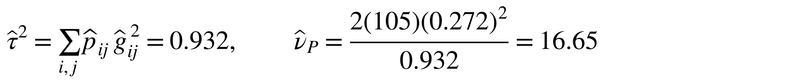
Worked example: sensitivities and degrees of freedom
Appendix · Method · example for Slides 16–20
Thesis table 𝑁^{𝑃}: one cell step by step, then all nine cells
Counts
Cell (1, 1), step by step
35 | 10 | 5 | 50
10 | 20 | 5 | 35
5 | 5 | 10 | 20
50 | 35 | 20 | 105
1 Pointwise MI
$${\hat{ℓ}}_{11}=log\frac{35/105}{\left(50/105\right)\left(50/105\right)}=0.385$$
2 MI and variance of pointwise MI
𝐼=𝑖,𝑗​ 𝑝𝑖𝑗 ℓ𝑖𝑗=0.137, 𝑉=𝑖,𝑗​ 𝑝𝑖𝑗ℓ𝑖𝑗−𝐼2=0.272
Row and column totals in grey; ${\hat{p}}_{ij}$ = 𝑛_{𝑖𝑗} / 105.
3 Row 1 mean (column 1 is the same, by symmetry)
Sensitivities of all nine cells
$${\overset{‾}{ℓ}}_{1+}=\frac{35\left(0.385\right)+10\left(−0.511\right)+5\left(−0.644\right)}{50}=0.103$$
0.422 | −1.048 | −1.382
−1.048 | 0.758 | −1.134
−1.382 | −1.134 | 1.620
4 Sensitivity
$${\hat{g}}_{11}={\left(0.385−0.137\right)}^{2}−0.272+2\left(0.385−0.103−0.103+0.137\right)=0.422$$
Calculated from thesis Equation 4.41. Their weighted mean is zero.
5 All nine cells
𝜏2=𝑖,𝑗​ 𝑝𝑖𝑗 𝑔𝑖𝑗 2=0.932, 𝜈𝑃=21050.27220.932=16.65
Thesis Section 4.4.1 (Equation 4.47). Cell (1, 1) adds (35/105)(0.422)² = 0.059 to the sum in step 5. Results use unrounded values
21
Notes:
Not part of the timed talk. Return to Slide 13 afterwards.
QUESTION ANSWERED
Can you show the calculation with numbers?
ANSWER TO GIVE
“For cell (1, 1), the count is 35 and its row and column each total 50, so its pointwise MI is 0.385. Across the table, MI is 0.137 and V is 0.272. Row 1's mean pointwise MI is 0.103, and column 1's is the same. The sensitivity is the squared deviation 0.062 minus 0.272, plus twice 0.316, which gives 0.422. Repeating this for all nine cells gives tau-squared 0.932, and the component degrees of freedom are 16.65.”
NOTES
Rounded thesis values: 0.38526, 0.13693, 0.27189, 0.10308, 0.4218, 0.93212 and 16.65. Row 1's pointwise-MI values are 0.38526, −0.51083 and −0.64436. The thesis prints only cell (1, 1)'s sensitivity; the other eight come from thesis Equation 4.41 and were recomputed from the counts, as were tau-squared and the df. Cell (1, 1) contributes 0.0593 to tau-squared. The results use unrounded values, so recomputing from the rounded inputs gives 16.67.
SOURCE
Thesis Section 4.4.1, Equations 4.41–4.43 and 4.47.

Slide 22
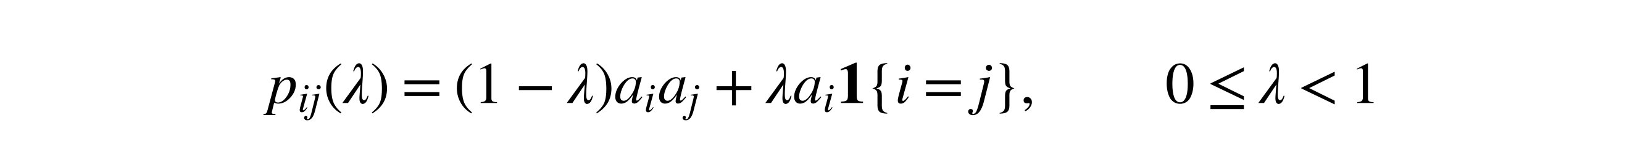
Population construction, grid, and calculation requirements
Appendix · Evaluation design · for Slide 6
Copying construction
$$p_{ij}\left(λ\right)=\left(1−λ\right)a_{i}a_{j}+λa_{i}1\{i=j\}, 0≤λ<1$$
Parameter grid
Calculation requirements and rates
k = 2, 4, 8, 16; uniform, same-skew,
or different-skew margins
n = 10, 20, 50, 100, 250, 500, 1,000, 2,500, 10,000, 50,000 per group
Same skew: both use 𝑚_{𝑘}(0.8).
Different skew: P uses 𝑚_{𝑘}(0.7), Q uses 𝑚_{𝑘}(0.8),
where 𝑚_{𝑘}(𝜌) = (𝜌, (1 − 𝜌)/(𝑘 − 1), …)
Null: shared MI 0.005, 0.02, 0.30.
Power: 𝐼(𝑃) = 0.02; 𝐼(𝑄) = 0.025, 0.03, 0.04
Each null or power study has 360 settings,
100,000 independent pairs per setting
A Wald calculation needs a finite difference and a positive finite standard error. Expanded Welch also needs positive finite degrees of freedom.
Rate = rejections from successful calculations / all repetitions.
Calculation success is reported separately.
Thesis Chapter 5 and Appendix B.1–B.5
22
Notes:
Not part of the timed talk. Return to Slide 13 afterwards.
QUESTION ANSWERED
How are known-MI populations generated and degenerate calculations handled?
ANSWER TO GIVE
“The copying probability changes association while preserving chosen margins. I solve it separately for each target MI. Unsuccessful calculations count as non-rejections, so the rate measures the complete procedure; calculation success is reported separately. Conditioning on success would describe a selected subset of sampled tables.”
NOTES
Full requirements (Appendix B.3): a Wald calculation succeeds when it has a finite corrected difference, a finite positive standard error, V-hat(P) + V-hat(Q) > 10^-14, and a finite p-value. The Expanded Welch calculation additionally requires positive finite component and combined degrees of freedom and a finite p-value; if either component fails, the Expanded Welch calculation is unsuccessful. If a sampled table has V-hat = tau-hat-squared = 0, the component formula requires 0/0, so the Expanded Welch calculation is unsuccessful even if the other table makes the shared standard error positive and finite. Zero and undefined component degrees of freedom are distinct cases; both fail the positive-finite requirement. A failed calculation is not evidence of equality.
Sampling is independent within and between populations, and both methods receive identical sampled pairs. The construction uses the same vector for row and column margins within each population and is one association family, not all categorical distributions.
SOURCE
Thesis Chapter 5 and Appendix B.1–B.5; current grid results.

Slide 23
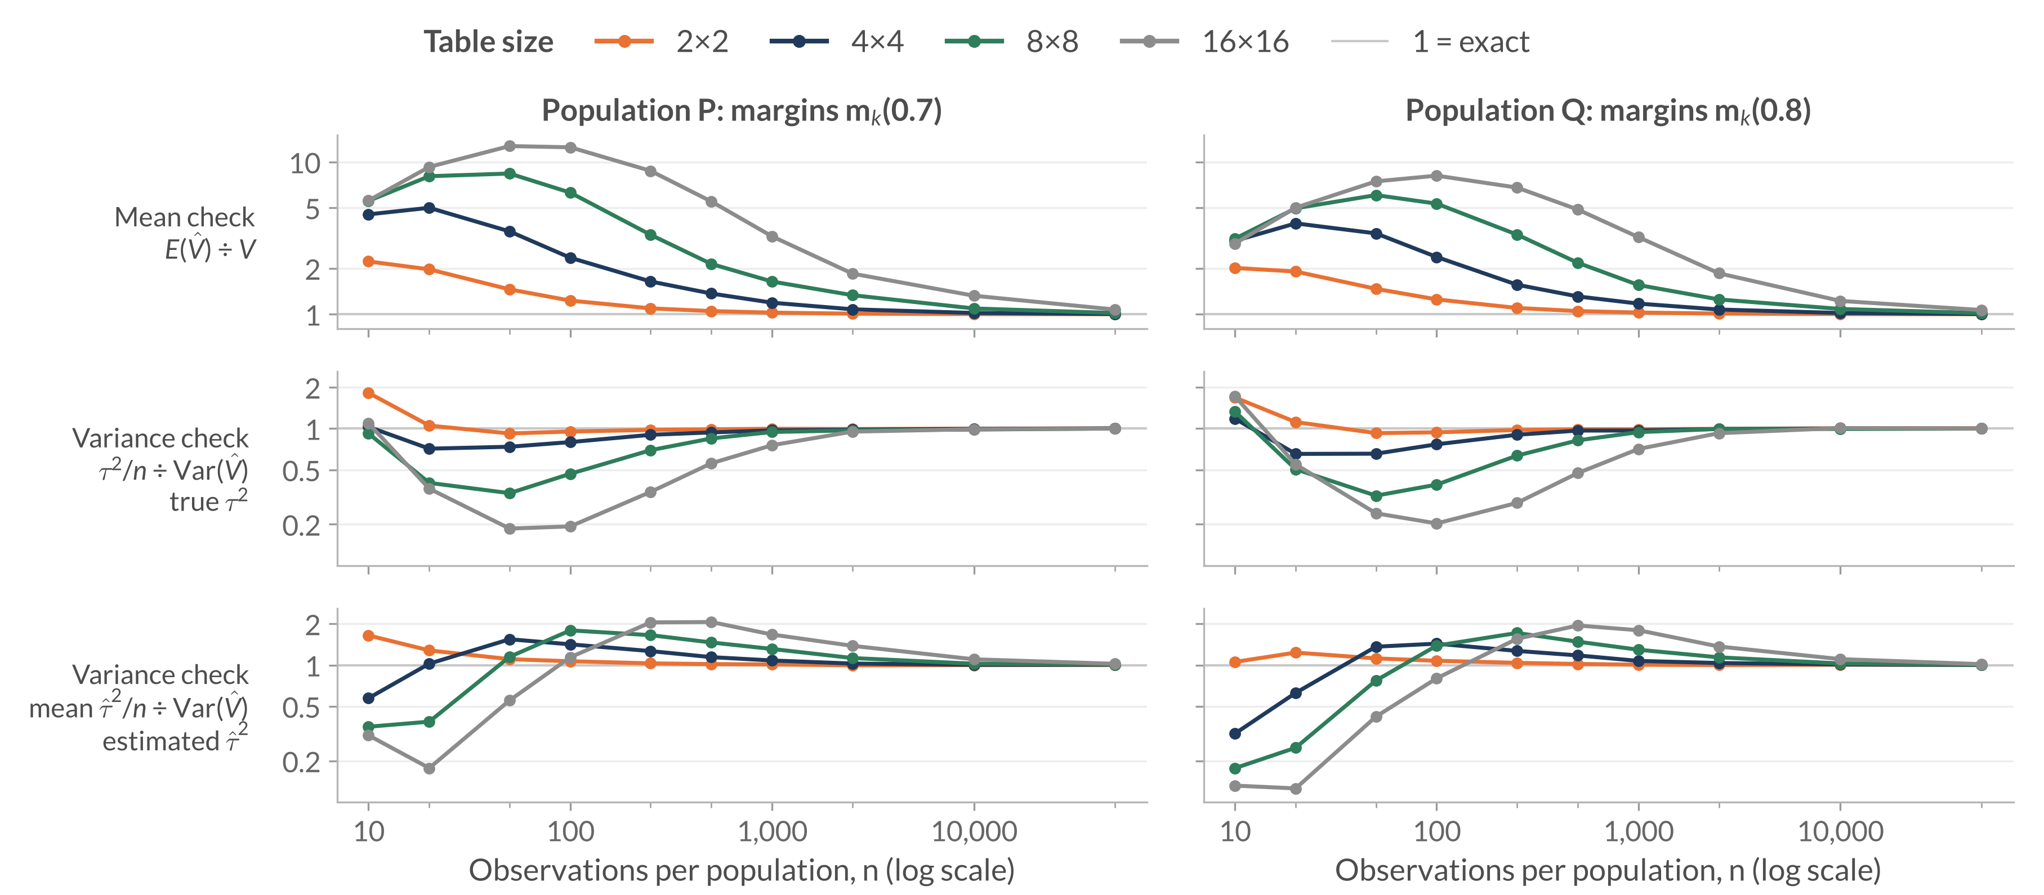
Approximation ratios across table sizes
Appendix · RQ1 · for Slide 7
Different-skew margins, shared MI 0.02 nats; a ratio of one indicates agreement
Rows as in thesis Figure 6.1. The variance checks use the true 𝜏² or the average estimated 𝜏̂² from 100,000 samples
23
Notes:
Not part of the timed talk. Return to Slide 13 afterwards.
WHEN OPENING
Colour now identifies table size; the rows are three different ratios.
QUESTION ANSWERED
Is the 4×4 example representative of other sizes and both populations?
ANSWER TO GIVE
“The larger tables generally have higher mean peaks, deeper population-variance troughs, and slower recovery in this family. Sample substitution can overpredict even while population inputs underpredict. The main slide isolates one slice so these quantities can first be understood separately.”
NOTES
Figure 6.2 separately checks how those moment errors affect df. In the worked 4×4/n=1,000 case, FO/target is about 0.73 and the exact values are 15.30/21.03; Slide 18's notes explain why. Do not infer the mean of estimated df by inserting mean inputs into a nonlinear ratio. Full current Figure 6.2 remains in the thesis; it is not needed as another timed slide.
SOURCE
Sections 6.1.1–6.1.2, Figures 6.1–6.2, and current moments.csv; expected 80 rows: 4 sizes × 10 sample sizes × 2 populations.

Slide 24
Near-independence noise calculation
Appendix · RQ1 · for Slide 8
Setting: 4×4, n = 1,000, MI 0.0001; 𝑑 = 9 and 𝜅 = 2𝑛𝐼(𝑃) ≈ 0.2
$$G=2n\hat{I}\left(P\right) \dot{∼} χ_{d}^{2}\left(κ\right), {\hat{ν}}_{P}≈G/2$$
In 𝐺, $\hat{I}\left(P\right)$ is the uncorrected plug-in MI, not a bias-corrected estimate.
Quantity | Local prediction | Observed (P)
Sample-based estimate (mean component df) | 4.60 | 4.86
Target (from sampling moments) | 9.00 | 9.12
Mean sample-based variance prediction / observed sampling variance | 1.96 | 1.97
Local approximations under fixed dimensions and positive limiting cell probabilities. Thesis Appendix A.2, Section 6.1.3
24
Notes:
Not part of the timed talk. Return to Slide 13 afterwards.
QUESTION ANSWERED
Why do the mean estimated df remain near five?
ANSWER TO GIVE
“Near independence, sampling noise creates apparent association. The quadratic likelihood-ratio approximation includes that noise. Substitution into the component formula gives roughly G divided by two, whose mean is about 4.6 in this setting. The population first-order formula instead approaches n times population MI. These are different approximations, which explains their separation.”
NOTES
Formulas: mean estimated component df (d + kappa)/2 = 4.60; sampling-moment target (d + kappa)^2/(d + 2 kappa) = 9.00; variance-prediction ratio 2(d + kappa)/(d + 2 kappa) = 1.96. The observed column is population P. The model predicts 9.00 for the target; it does not predict the observed 9.12 exactly.
SOURCE
Thesis Appendix A.2 and Section 6.1.3; Figure 6.3. These are local approximations under fixed dimensions and positive limiting cell probabilities, not exact finite-sample distribution identities.

Slide 25
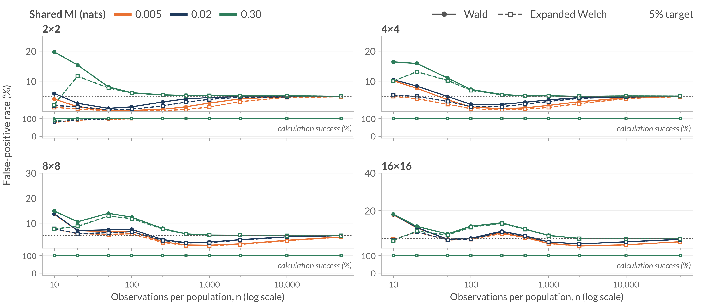
Full null results: uniform margins
Appendix · RQ2 · for Slide 9
Equal MI in P and Q; uniform margins in both populations
Rates divide rejections by all 100,000 repetitions; unsuccessful calculations count as non-rejections. Requirements on Slide 22. Thesis Figure 6.4
25
Notes:
Not part of the timed talk. Return to Slide 13 afterwards.
WHEN OPENING
Colours here identify the shared MI, not the method: solid lines with filled circles are the Wald test, dashed lines with open squares are the Expanded Welch test. Lower strips show calculation success.
QUESTION ANSWERED
What happens outside the highlighted different-skew 16×16 example?
ANSWER TO GIVE
“Under the copying construction, equal MI and uniform margins give identical population tables. Their expected MI biases cancel in the difference, but errors in the uncertainty estimate and reference distribution can still cause excessive or conservative rejection. Increasing shared MI changes those patterns.”
NOTES
All 120 settings for the uniform profile. Slide 9 plots each setting here as one point; its 8.35% to 4.90% example is the 4×4, n = 20, MI 0.02 setting.
SOURCE
Final Figure 6.4 and balanced-null combined rates, uniform profile. This page contains all 120 settings for that profile.

Slide 26
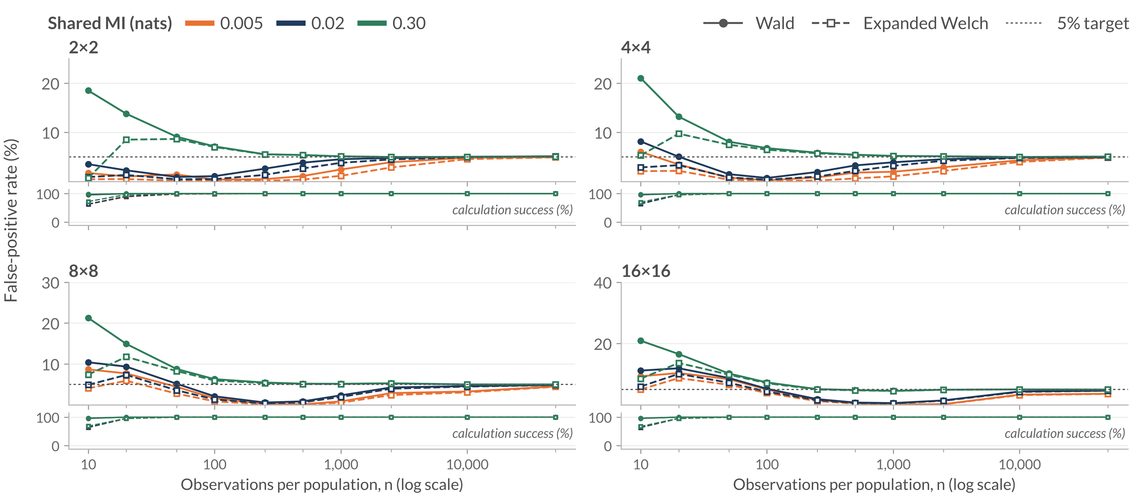
Full null results: same-skew margins
Appendix · RQ2 · for Slide 9
Equal MI; same-skew margins m_{k}(0.8) in P and Q
Rates divide rejections by all 100,000 repetitions; unsuccessful calculations count as non-rejections. Requirements on Slide 22. Thesis Figure 6.5
26
Notes:
Not part of the timed talk. Return to Slide 13 afterwards.
WHEN OPENING
Colours here identify the shared MI, not the method: solid lines with filled circles are the Wald test, dashed lines with open squares are the Expanded Welch test. Lower strips show calculation success.
QUESTION ANSWERED
What changes when both populations have the same uneven category frequencies?
ANSWER TO GIVE
“The population tables are still identical under equal MI, so expected bias in the difference cancels. Uneven margins leave more rare category combinations. The conservative ranges persist beyond the smallest samples and are not explained solely by calculation failures. Expanded Welch lowers those already-low rates further.”
NOTES
All 120 settings for the same-skew profile.
SOURCE
Final Figure 6.5 and balanced-null combined rates, same-skew profile. This page contains all 120 settings for that profile.

Slide 27
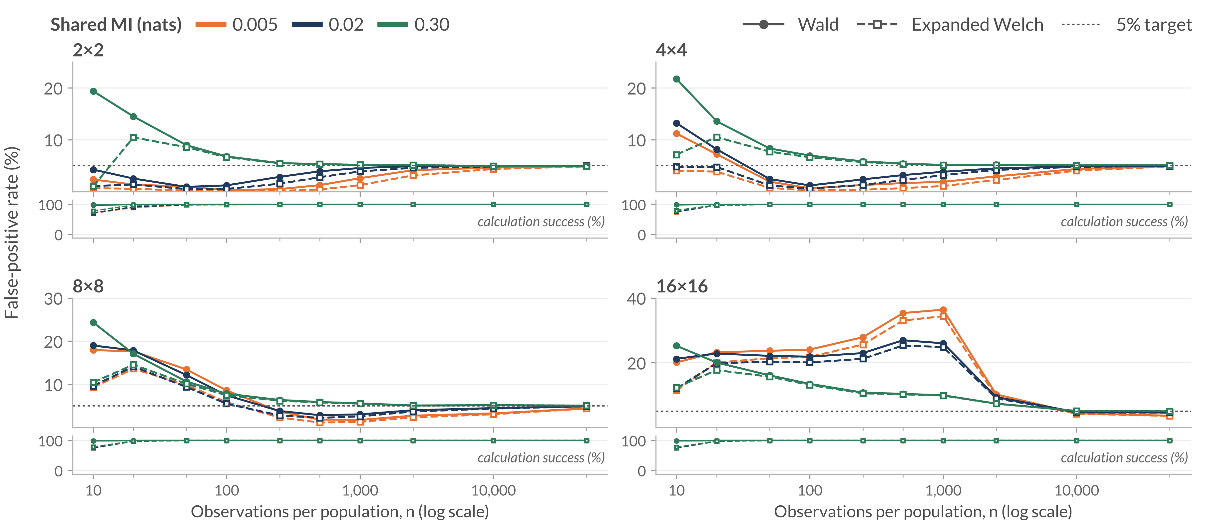
Full null results: different-skew margins
Appendix · RQ2 · for Slide 9
Equal MI; m_{k}(0.7) in P and m_{k}(0.8) in Q
Rates divide rejections by all 100,000 repetitions; unsuccessful calculations count as non-rejections. Requirements on Slide 22. Thesis Figure 6.6
27
Notes:
Not part of the timed talk. Return to Slide 13 afterwards.
WHEN OPENING
Colours here identify the shared MI, not the method: solid lines with filled circles are the Wald test, dashed lines with open squares are the Expanded Welch test. Lower strips show calculation success.
QUESTION ANSWERED
Are the severe failures restricted to the largest table, and what is visible over the complete margin-specific grid?
ANSWER TO GIVE
“Here equal MI permits different population tables. The remaining MI biases need not cancel, and in the sparse largest table they can shift the estimated difference substantially away from zero. The smaller-table patterns and the dependence on shared MI remain visible in this complete slice of the null grid.”
NOTES
All 120 settings for the different-skew profile. The Slide 10 diagnostic table uses the MI 0.02, n = 1,000 slice of these populations.
Additional anchor: At MI .005, n=1,000, and 16×16, Wald is 36.38% and Expanded Welch 34.38%, with every calculation successful in both tests. This is a different shared-MI level from the diagnostic table's .02; do not interchange the numbers.
SOURCE
Final Figure 6.6 and balanced-null combined rates, different-skew profile. This page contains all 120 settings for that profile.

Slide 28
Ordinary Welch degrees of freedom
Appendix · RQ2 · for Slide 10
Same statistic and sampled pairs; ordinary Welch gives each component 𝑛 − 1 degrees of freedom; shared MI 0.02 nats
Setting | Wald | Ordinary Welch | Expanded Welch
Uniform 4×4, n = 20 | 8.35% | 7.35% | 4.90%
Uniform 4×4, n = 50 | 4.87% | 4.57% | 3.24%
Different skew 16×16, n = 1,000 | 26.01% | 25.95% | 24.84%
False-positive rates; nominal target 5%.
n = 20
Ordinary Welch reduces the excess less than Expanded Welch.
n = 50
Wald is already close to 5%; Expanded Welch is the most conservative.
Different skew 16×16
Neither choice removes the excess caused by bias.
Conclusion: MI-specific degrees of freedom change the results,
but a larger reduction in rejection does not consistently improve calibration.
Same 100,000 sampled pairs per setting as the null study; every calculation succeeds. Thesis Section 6.2.5, Table 6.2
28
Notes:
Not part of the timed talk. Return to Slide 13 afterwards.
QUESTION ANSWERED
Would ordinary Welch degrees of freedom work as well as the MI-specific calculation?
ANSWER TO GIVE
“Ordinary Welch keeps the same estimated MI difference, standard error, and statistic, but gives each component n minus one degrees of freedom, the rule for comparing sample means. For MI that is only a benchmark, because it ignores how the pointwise-MI variance estimate changes with the table. At n = 20 it removes less of the excess than Expanded Welch. At n = 50, where Wald is already close to 5%, Expanded Welch becomes the most conservative. In the biased 16×16 case neither choice removes the excess. So the MI-specific calculation changes the results, but a larger reduction in rejection does not consistently improve calibration.”
NOTES
The three settings reuse the main null study's 100,000 sampled pairs per setting at shared MI 0.02 nats with n_P = n_Q = n; all three methods' calculations succeed in every repetition. The thesis examines ordinary Welch only at these illustrative settings and lists this as a limitation (Section 7.2); the main comparison is with the Wald test.
SOURCE
Thesis Section 6.2.5, Table 6.2; Section 7.2.

Slide 29
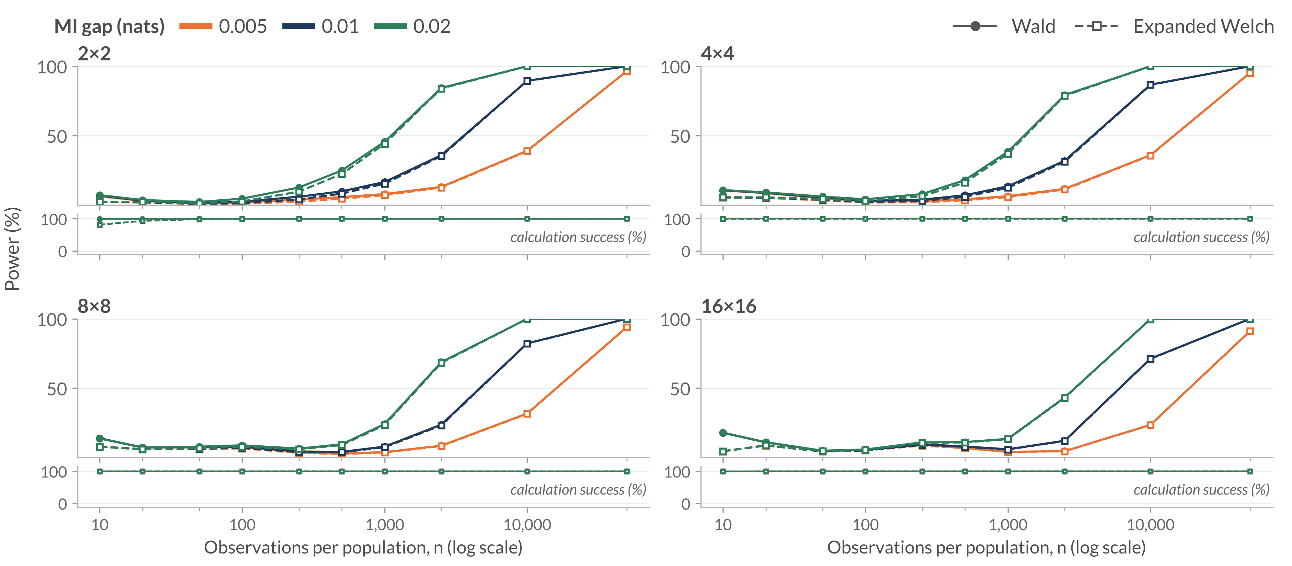
Full power results: uniform margins
Appendix · RQ3 · for Slides 11–12
Uniform margins; MI in P = 0.02 nats
Rates divide rejections by all 100,000 repetitions; unsuccessful calculations count as non-rejections. Requirements on Slide 22. Thesis Figure 6.7
29
Notes:
Not part of the timed talk. Return to Slide 13 afterwards.
WHEN OPENING
Colours here identify the MI gap, not the method: solid lines with filled circles are the Wald test, dashed lines with open squares are the Expanded Welch test. Lower strips show calculation success.
QUESTION ANSWERED
How does absolute power change with MI gap, sample size, and table size under uniform margins?
ANSWER TO GIVE
“The complete uniform-margin grid shows the increase in detection with sufficient observations and the stronger-gap advantage. Larger tables need more data. Expanded Welch never exceeds Wald under the usual thresholds, with method differences becoming small at larger sample sizes.”
NOTES
120 settings, 240 method rows for this margin profile.
SOURCE
Section 6.3.1, Figure 6.7; power rates, profile=uniform, denominator=all. At n=10,000 and gap=.01, EW is 89.44% for 2×2 and 71.12% for 16×16. These values describe the stated population family.

Slide 30
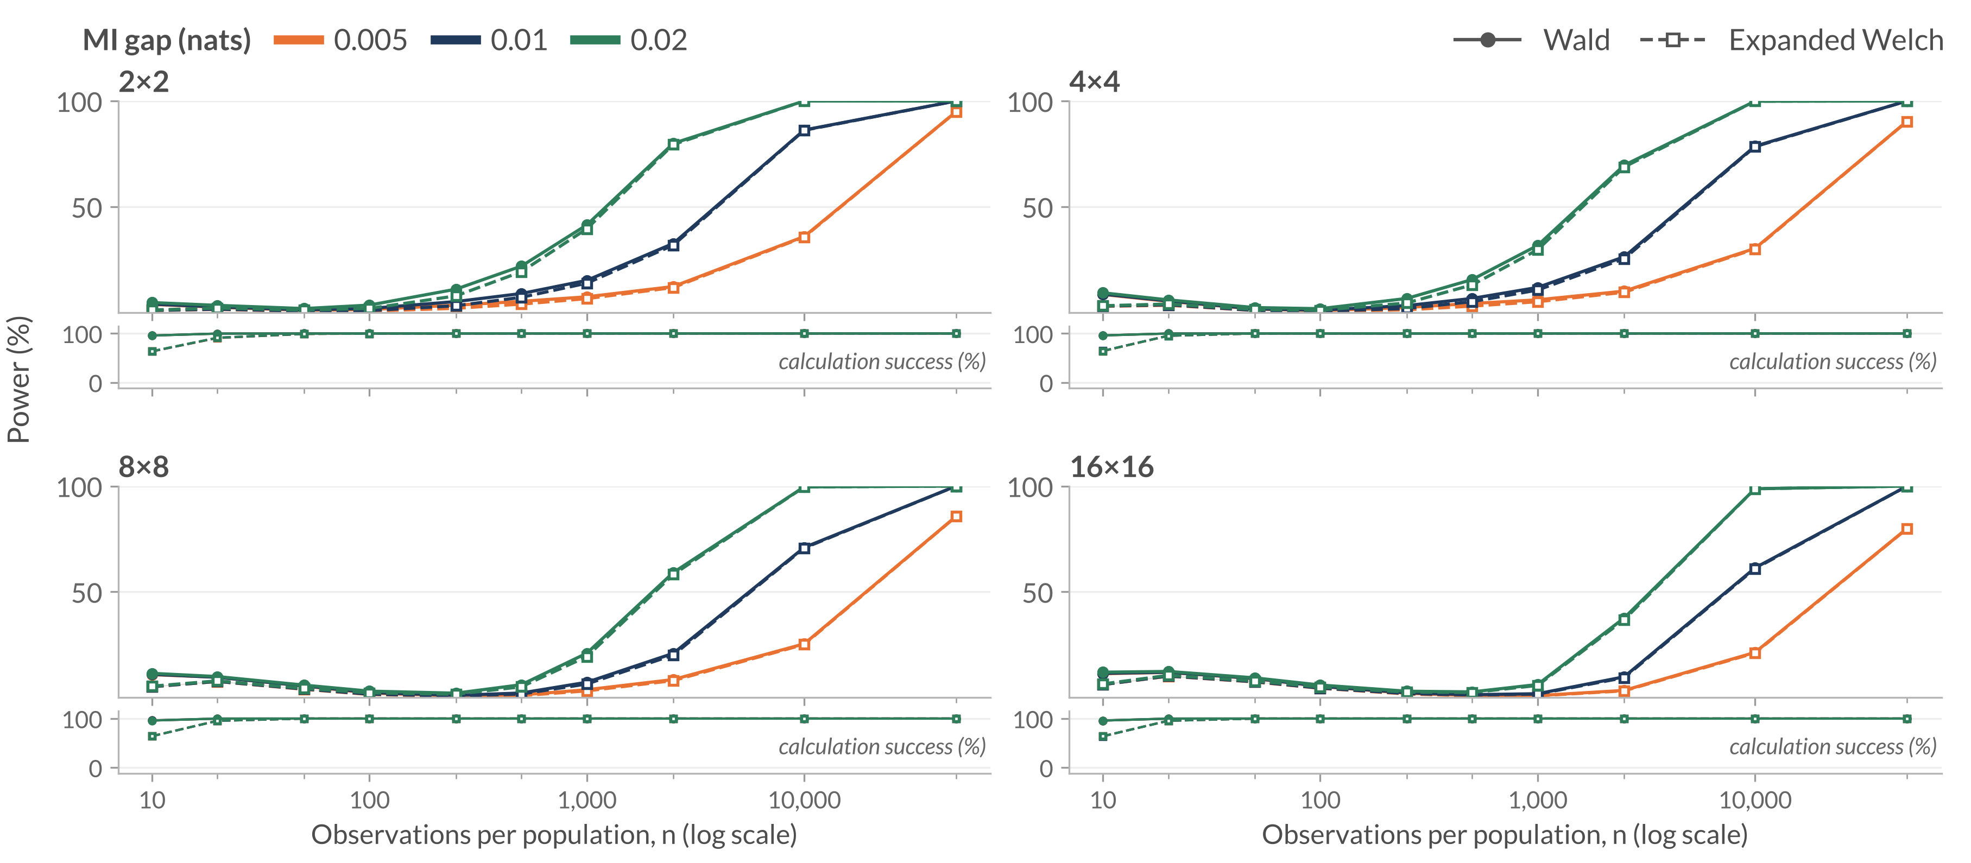
Full power results: same-skew margins
Appendix · RQ3 · for Slides 11–12
Same-skew margins m_{k}(0.8) in P and Q; MI in P = 0.02 nats
Rates divide rejections by all 100,000 repetitions; unsuccessful calculations count as non-rejections. Requirements on Slide 22. Thesis Figure 6.8
30
Notes:
Not part of the timed talk. Return to Slide 13 afterwards.
WHEN OPENING
Colours here identify the MI gap, not the method: solid lines with filled circles are the Wald test, dashed lines with open squares are the Expanded Welch test. Lower strips show calculation success.
QUESTION ANSWERED
Do the power patterns also occur when both groups have the same uneven margins?
ANSWER TO GIVE
“These power curves use the same uneven margins in both populations. Larger tables need more observations, and the smaller MI gap remains harder to detect. For example, at n=50,000, the 16×16 Expanded Welch power is 79.87% for the smallest gap, compared with more than 99.9% for each of the two larger gaps. The method difference is smaller than these gap and setting effects at larger sample sizes.”
NOTES
All 120 settings for the same-skew power profile.
SOURCE
Final Figure 6.8; Section 6.3.2; MI-gap combined rates, same-skew profile. This page contains all 120 settings for that profile.

Slide 31
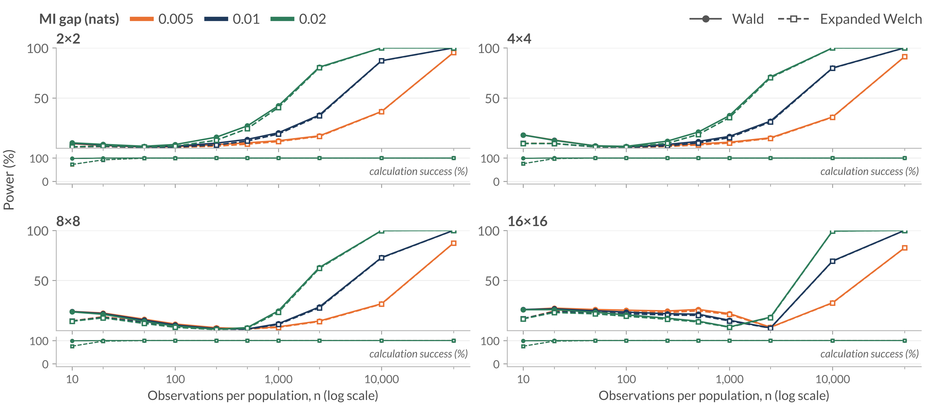
Full power results: different-skew margins
Appendix · RQ3 · for Slides 11–12
m_{k}(0.7) in P, m_{k}(0.8) in Q; MI in P = 0.02 nats
Rates divide rejections by all 100,000 repetitions; unsuccessful calculations count as non-rejections. Requirements on Slide 22. Thesis Figure 6.9
31
Notes:
Not part of the timed talk. Return to Slide 13 afterwards.
WHEN OPENING
Colours here identify the MI gap, not the method: solid lines with filled circles are the Wald test, dashed lines with open squares are the Expanded Welch test. Lower strips show calculation success.
QUESTION ANSWERED
How does the bias-related failure vary with gap and table size?
ANSWER TO GIVE
“Unequal residual biases can shift the estimated difference opposite to its true sign. The two-sided rate includes those rejections. As the bias shrinks, rejection can first fall and later recover. Gap size and margins therefore affect power through the estimator's behaviour as well as the true separation.”
NOTES
120 settings, 240 method rows. The main point is 16×16, gap 0.01, n = 1,000.
At the main point the mean estimate is +.0206714 for true −.01. Of 9,662 EW rejections, 9,659 are positive and 3 negative. Do not apply that conditional percentage to the entire grid or all 100,000 estimates.
SOURCE
Section 6.3.3, Figure 6.9, and current power CSVs, profile=different_skew, denominator=all.

Slide 32
References: MI and testing foundations
Appendix · References
Bossomaier, T., Barnett, L., Harré, M. and Lizier, J. T. (2016). An Introduction to Transfer Entropy: Information Flow in Complex Systems. Springer, Cham. doi:10.1007/978-3-319-43222-9
Miller, G. A. (1955). Note on the bias of information estimates. In H. Quastler (Ed.), Information Theory in Psychology: Problems and Methods (pp. 95–100). Free Press, Glencoe, Illinois.
Moddemeijer, R. (1989). On estimation of entropy and mutual information of continuous distributions. Signal Processing, 16(3), 233–248. doi:10.1016/0165-1684(89)90132-1
Mora, R. and Ruiz-Castillo, J. (2009). The statistical properties of the mutual information index of multigroup segregation. Working Paper, Economic Series (48), 09-84, Universidad Carlos III de Madrid, Departamento de Economía.
Paninski, L. (2003). Estimation of entropy and mutual information. Neural Computation, 15(6), 1191–1253. doi:10.1162/089976603321780272
Satterthwaite, F. E. (1946). An approximate distribution of estimates of variance components. Biometrics Bulletin, 2(6),
110–114. doi:10.2307/3002019
Welch, B. L. (1947). The generalization of “Student’s” problem when several different population variances are involved. Biometrika, 34(1–2), 28–35. doi:10.1093/biomet/34.1-2.28
32
Notes:
Not part of the timed talk. Use this page if a source is requested. Entries follow the thesis bibliography.

Slide 33
References: related methods and evaluation
Appendix · References
Chao, A. and Shen, T.-J. (2003). Nonparametric estimation of Shannon’s index of diversity when there are unseen species in sample. Environmental and Ecological Statistics, 10(4), 429–443. doi:10.1023/A:1026096204727
Hutcheson, K. (1970). A test for comparing diversities based on the Shannon formula. Journal of Theoretical Biology, 29(1),
151–154. doi:10.1016/0022-5193(70)90124-4
Morris, T. P., White, I. R. and Crowther, M. J. (2019). Using simulation studies to evaluate statistical methods. Statistics in Medicine, 38(11), 2074–2102. doi:10.1002/sim.8086
Nemenman, I., Shafee, F. and Bialek, W. (2002). Entropy and inference, revisited. In T. G. Dietterich, S. Becker and Z. Ghahramani (Eds.), Advances in Neural Information Processing Systems 14 (pp. 471–478). MIT Press.
Pan, W. and Wall, M. M. (2002). Small-sample adjustments in using the sandwich variance estimator in generalized estimating equations. Statistics in Medicine, 21(10), 1429–1441. doi:10.1002/sim.1142
Panzeri, S. and Treves, A. (1996). Analytical estimates of limited sampling biases in different information measures. Network: Computation in Neural Systems, 7(1), 87–107.
doi:10.1088/0954-898X/7/1/006
Wald, A. (1943). Tests of statistical hypotheses concerning several parameters when the number of observations is large. Transactions of the American Mathematical Society, 54(3), 426–482. doi:10.1090/S0002-9947-1943-0012401-3
33
Notes:
Not part of the timed talk. Use this page if a source is requested. Entries follow the thesis bibliography.

